Slide 1

Relationship Management
Robyn Webb – Executive Director
Alida Campbell – Program Manager
Notes:
Introduce Topic
ROBYN AND ALIDA
Discussing this because relationships can really improve the Connector Program’s stead in a community. They can truly change how you run the program, and how successful it can be in many situations.

Slide 2

Outline
What do we mean by Partners?
Relationship Benefits
Communication
Investment into and Benefits from the Relationship
Expansion of the Relationship
Being Strategic
Notes:
ALIDA
Discusses the outline and flow of presentation
Robyn and I are here to present this information, but there are examples in here, or points we’ll make, where some of you might be the experts. Please feel free to add your expertise, examples, ideas, thoughts into the presentation. Your contributions and examples will make this much more rich!

Slide 3
PARTNERS

Slide 4
Partners means….
Local Immigration Partnerships,
Service Provider Organizations,
Funders,
Sponsors,
Higher education institutions,
Businesses,
Connector Organizations,
Collaborative organizations
Notes:
ALIDA
What we mean by partners – it’s a very broad term, but everything we are discussing here today applies to each of these examples.

Slide 5
RELATIONSHIP BENEFITS

Slide 6
What’s in it for them? For us?
Everyone should benefit from a relationship – that’s why they are in it to start!
Always determine what your benefits are, and what their benefits are.
  ISANS
    Quarterly reports
    Sector Focii
    Employer job referrals
Determine your reasons, and their reasons for engaging – it helps steer where the relationship should go
Notes:
ALIDA
Relationships are always two-sided. So you should always be thinking what you can offer the other party, and what you are gaining from the relationship. You want to make sure it is not a one-sided affair, and you aren’t leaving opportunities on the table, or you aren’t overworking yourself for very little program gain.
ROBYN
ISANS story.
What do you want from the relationship? Knowing this from the outset helps you determine what you should offer, what you should ask for, and how to best go about those things.

Slide 7
Professional Development and Relationships
Corporate Social Responsibility, Professional Development, and other examples of community engagement within an organization can benefit the Connector Program and deepen the relationship
  For Example - RBC
Notes:
ROBYN
RBC
Irving Shipbuilding

Slide 8
COMMUNICATION

Slide 9
Communication Matters
For your major relationships
  Have a quarterly check-in booked into your calendar
  Face to face if you can!
Social Media
  Follow and support them, and have them do the same
  Promote their opportunities, posts etc it shows they are top of mind, and you consider it a partnership
Maintain Information
  Keep your contacts up to date so you always have a line into the organization
  Say thank you to those who leave, welcome new people and establish the relationship right away
Continual Contact
  If they aren’t major relationships, work to establish continual contact – send them great Connectees, invite them to events, and receive their job postings.
Notes:
ROBYN
For your major relationships.
ALIDA
Social Media – whether we like it or not, social media is a useful and ubiquitous tool in today’s world. It makes a difference to organizations whether you are engaged on various platforms, and what your engagement looks like. Actively liking, sharing, commenting and following posts, and organizations will not go unnoticed by your partners. So make sure to engaging in these things. You can do this from your personal accounts, or get your social team on board and let them know the purpose behind your ask to follow/comment/like/share.
This shows that you are committed to the relationship, and that you want to help them in any way you can. It also shows your support for their programming. If it helps your audience see their content, that is also all the better.
ALIDA
Maintain Information – Make sure you always know who your main contact is, what their role is, and if they are moving, leaving, etc. There is nothing worse than having your one contact leave without you knowing – or getting bounce back emails when you want to engage the organization for one reason or another. When you do get word that someone is leaving, send them a thank you note, and ask for a new contact at the organization who will take on your partnership. Welcome the new person, and establish the relationship right away. Try not to rely on only one person in the organization as your main contact – it’s always best to have numerous contacts in any organization – it helps with turnover as well, to ensure the relationship continues.
ROBYN
Continual Contact

Slide 10
Know Your Organizations
Make sure to know the organizations you are dealing with
  Who should you be talking to?
    If you only have one contact – your relationship is at risk
How should you engage with the organization?
  What’s the best way to have your voice heard?
  What can you offer the organization, and what can they do for you?
The more you know, the better you can position the relationship – and the more successful it can be
Notes:
ALIDA
Knowing who your partners are, what they do, what their work is in the community will help you know who you should be talking to at the organization. Some organizations will need multiple points of contacts across different units – for example, PSIs or Banks, and some might only need one main contact in one department. Always try to have at least two contacts – your relationship might be at risk otherwise.
ROBYN
How should you engage and the more you know (will refer to this later)

Slide 11
BENEFITS AND INVESTMENTS

Slide 12
Everything is a Give and Take…
A relationship is an investment that should always pay off – some ideas to lean into are:
  Offer opportunities you are privy to
    ACCES and Connecting Canada
    Skills for Hire and NCP
  Give organizations access to talent
  Give organizations more opportunities to show their scope
    Manulife and Halifax Partnership
  Events such as Speed Interviews, Speed Networking, Career Fairs
Notes:
ALIDA
Just as in your personal life, a relationship should always bring something to you, and you’ll have to give something to it to make it grow and blossom. There are always ways to lean into a relationship – some of course will take more time than others, but that’s for you to determine based on your relationships, your community, and what will work for your organization and program.
You can offer opportunities you are privy to (ACCES EXAMPLE, Skills for hire,
ROBYN
Access to Talent
Manulife example
Speed interviews and other event examples

Slide 13
Thought Leadership
You are the networking experts!
Showcase this and offer your expertise to organizations
Offer workshops, toolkits, discussions to your partners to help their clients/staff
Notes:
ALIDA
You are the experts in networking – intentional and otherwise, networking is your area of expertise – so use this to start, develop, further, and enrich your relationships.
Make sure organizations know that you have this knowledge, and you can share it with them in order to help their staff, their clients, and their organization as a whole benefit from your expertise.
You can offer workshops, toolkits, discussions etc to your partners, and they’ll be so pleased with their new knowledge in this area!
ROBYN
Examples of the HP program – NSCC, RBC, etc.

Slide 14
EXPANDING THE RELATIONSHIP

Slide 15
Expand and Deliver!
You can be a useful resource for new businesses in your region/community
Use events to your advantage
  For example, Halifax Partnership and Mass tech layoffs
Increase the depth of engagement
  Organize an annual check-in with the partner to discuss opportunities, weaknesses, and ways to expand
    If it’s just you – bring in your whole organization, and see how you can deepen the relationship, and include the Connector Program
Notes:
ROBYN
Be a useful resource for new businesses
Use events to your advantage
ALIDA
If you have some major partners, always be on the lookout to increase engagement with them. If you have partners, you’d like to have more dealings with – then find ways to further that relationship and increase the depth of your activities with them.
You can have annual check ins with those you are looking to do more with – have an in person, several hour meeting where you can really dig deep into what you can accomplish together, what the relationship could be, and how you might go about doing it.
We know some of you are from small organizations, or are a one person team – so use this to your advantage, and bring the whole organization with you. The Connector program can be a part of this discussion, and then not only your program, but your whole organization benefits from this conversation. It also helps to increase awareness of what you do within your own team, and perhaps could create synergies, and partnerships within your own business units. Think about how you might go about doing this!

Slide 16
Relationship Intentionality
Always have a plan
  What are the intentions of the relationship?
  Why are you pursuing the relationship? Why are they?
    For example:
      A sponsorship is great – but what is your commitment and is it worth the gains?
      Are the objectives realistic? What is the return for you?
Be Strategic as well
  For example, Post Secondary Institutions
    Know who to talk to, and what part to engage for what purpose
      Halifax Partnership and MTEI program
Notes:
ROBYN
First bullet section – talk about the plan of a relationship and why it’s important
ALIDA
Strategy in who to engage, how to engage them, and when to ask for what is really important. For example, if you are dealing with post secondarys – one contact in one place isn’t enough. You need to think about who to engage, and what you’ll get out of it. Are your companies wanting business grads, or grads with soft skills/ people that can write? When you need to approach different faculties, or different units to find how you can engage those students.
HP and the MTEI program example

Slide 17
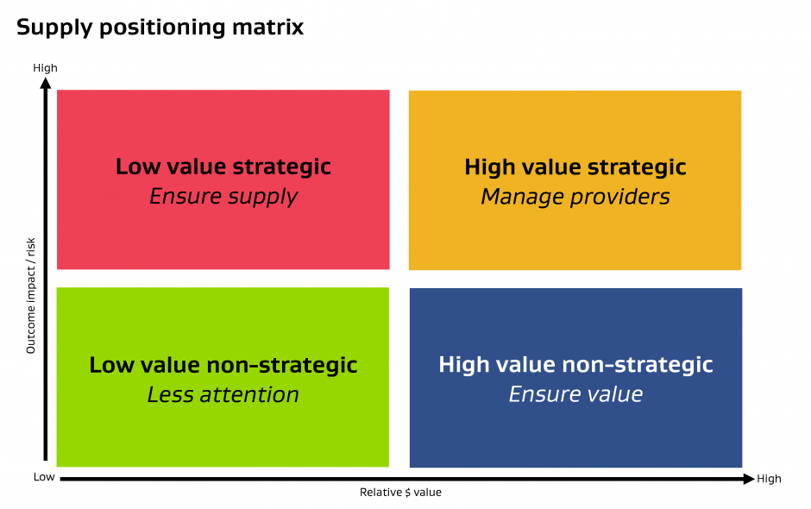
Relationship Strategic Plan
Think about all the relationships you have – the Big picture
Who are your strategic partners? Where do you want to grow?
Show up in different ways for High value strategic
  i.e. Sit on a board, volunteer at an organization etc.)
Notes:
ROBYN
Talk to whole slide.

