Slide 1






Networking 101
Turn Network Into
Net-Worth
Northern Connector Program
Presented by:
Nathan Laird, Program Manager, Halifax Connector Program
Notes:
Thank you, for the introduction.
Hello everyone. I’m Matthew Berrigan, the Regional Manager of the Northern Nova Scotia Connector Program, a collaborate initiative of the Cumberland Business Connector, Truro/Colchester Partnership, and Pictou County REN, in partnership with the National Connector Program. I’m thrilled to be here today to meet with you all to celebrate small business week..
Previously employed with the Eastern-Strait Connector Program, I will be joining the Cumberland Business Connector to help newcomers and skilled professionals connect with community and business leaders in our region.

Slide 2


What is Networking?
The action or process of interacting with others to exchange information and develop professional or social contacts.
A Network consists of 2 or more that are linked in order to share resources

Slide 3
Types of Networking?

Slide 4

  DISCOVER opportunities
  UNCOVER the hidden job market
  GROW your professional network
Notes:
Discover opportunities
Increase your chances to find out about job openings that are otherwise not advertised
Upcoming short-term projects, volunteer opportunities, conferences, etc.
Discovering opportunities outside your industry. For example if you’re in PR and only look at events involving PR agencies or targeting a PR crowd, you may lose opportunities that could arise in IT or Finance related events. Many IT companies and financial institutes have a PR/marketing department, so there could be a missed opportunity there.
Tap into the hidden job market
A significant number of jobs are never posted, but rather filled through people leveraging their personal networks
Grow your professional network
Provides you with invaluable opportunity to best prepare you for your career goals
Gathering information about your field or industry
Networking is a mutual process – you never know when your skills and resources can prove to be beneficial to others in your network
Recruiters typically spend about 10 seconds browsing your resume, and having a connection at a given company can help move your resume to the “interview” stack
Networking should also be approached as an ongoing process that takes time and nurturing, and not something you do just when you are looking for a job.

Slide 6
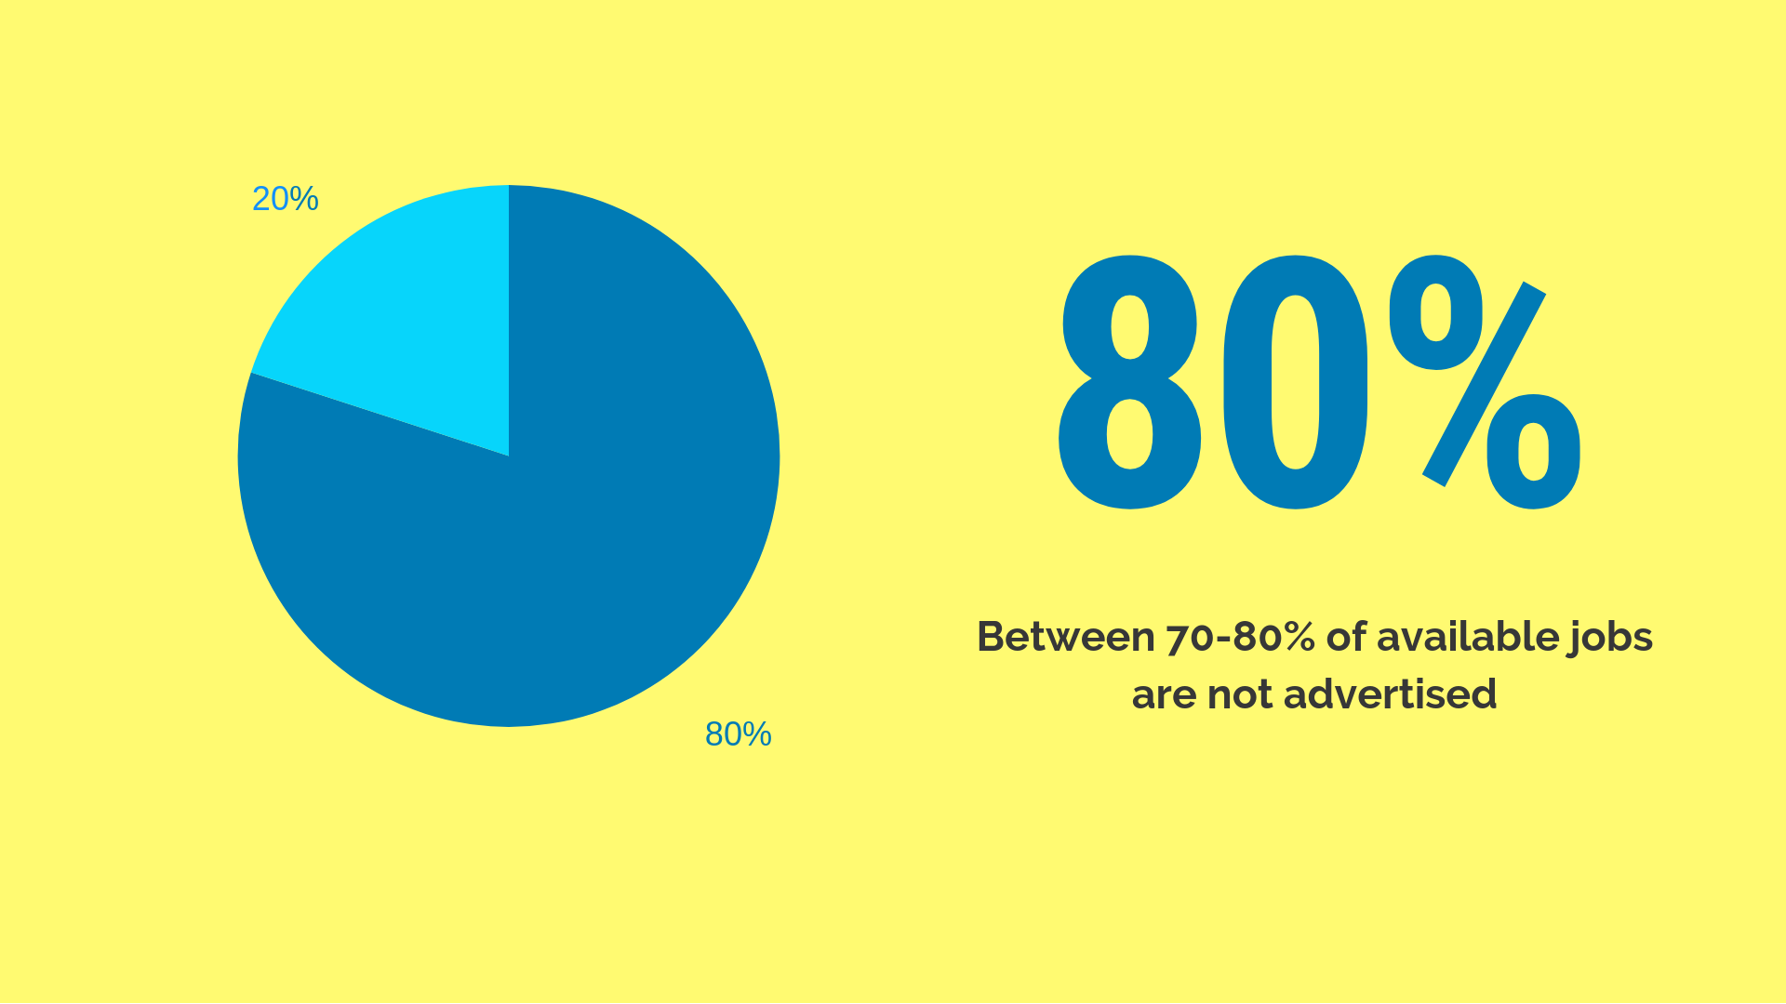

Slide 7
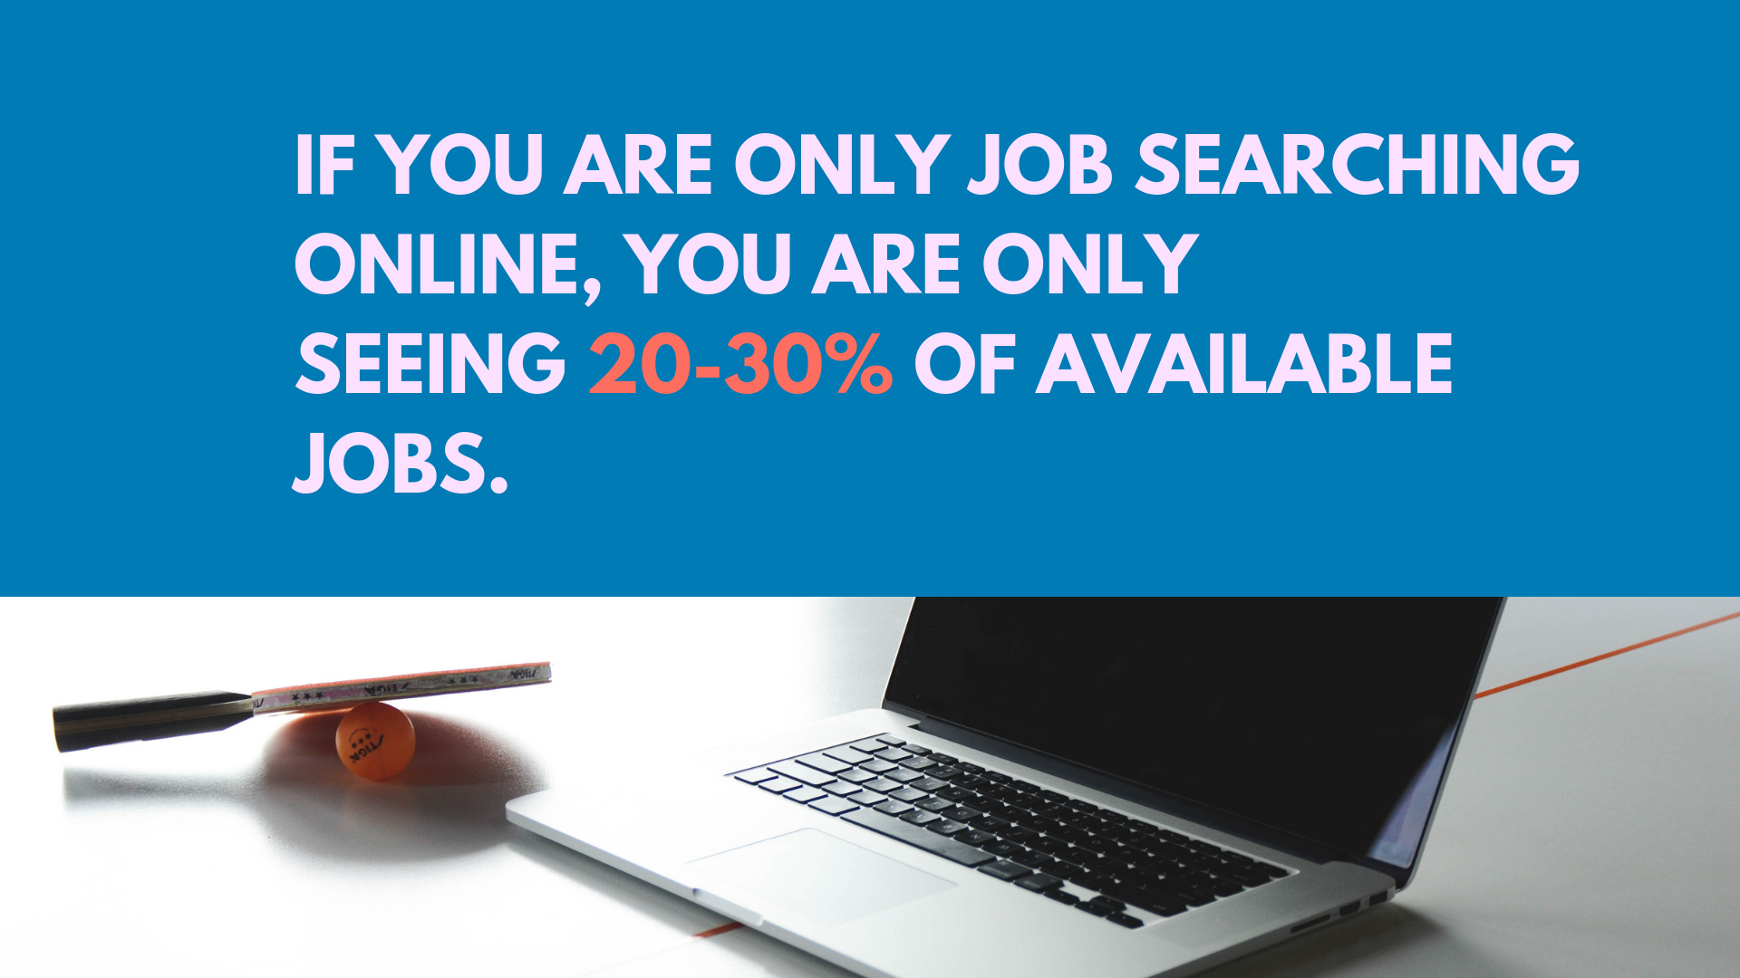

Slide 8

NETWORKING BY THE NUMBERS
64%
Said in-person networking helped them find a new job
or advance their career
88%
Said networking directly or indirectly helped
their careers
69%
Said they found increased job opportunities
as a result of networking
Notes:
From a couple different resources, but they are Canadian Stats.

Slide 9


Slide 10
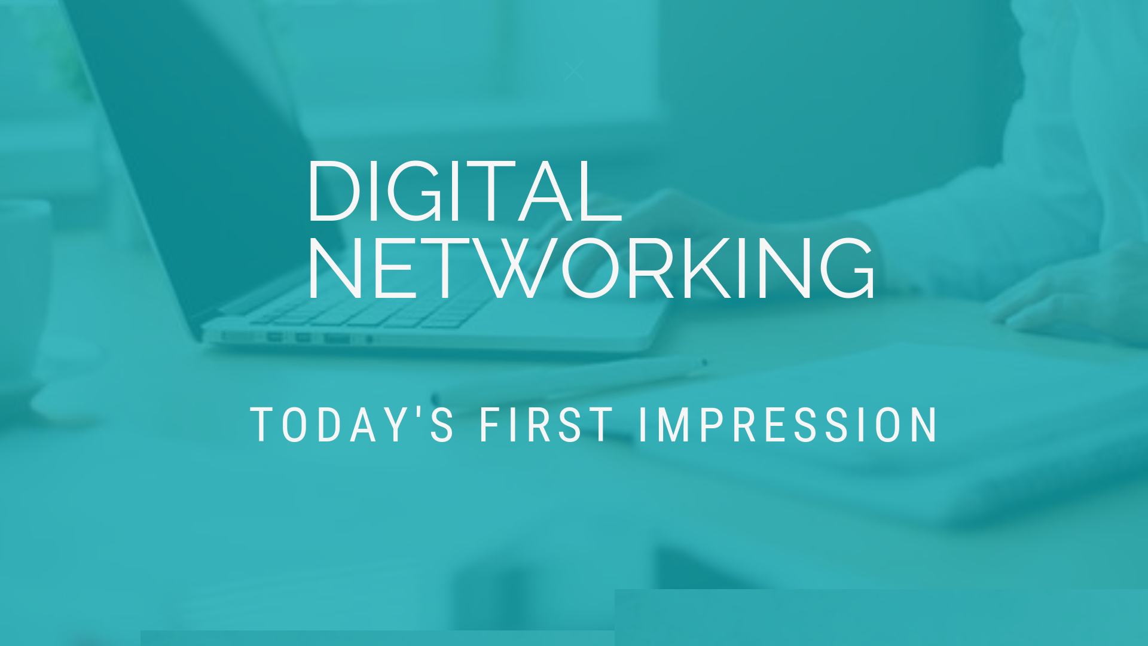

Slide 11


DIGITAL NETWORKING
  Job seekers can identify target organizations or individuals and contact them
  Employers can headhunt specific skills/backgrounds
  Having a strong LinkedIn profile can be a differentiator in a job interview
  What do you think makes a great LinkedIn profile?
Notes:
Recap
LinkedIn has revolutionized networking and recruiting.

Slide 12
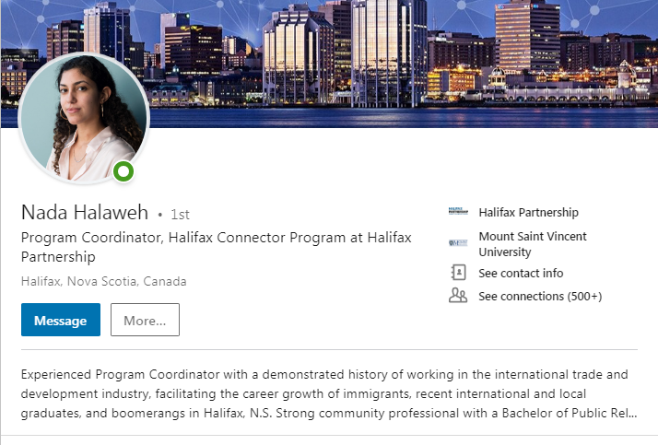
TIPS
Professional headshot
Complete and up-to-date information
Carefully chosen groups
Well written summary
Professional experience and education
Languages, certifications, and publications
Clean URL
https://www.linkedin.com/in/nada-halaweh
Notes:
Headshot: important to keep in mind that employers, Business leaders, recruiters, etc. will be seeing this photo when they view your profile.
Information: receiving a new position, promotion or new job are all things that should be reflective on your profile. It’s important all your information is updated with recent changes.
Groups: it’s important to choose your groups carefully, you want to pick the ones most relevant to your interests and passion. Ultimately, the groups you choose can be seen as a reflection of the type of person you are.
Summary: the LinkedIn summary is a good place to briefly share your story, however it should not be confused with the experience section. The complete narrative should give reflection of your values, passions and strengths. It should give people a good understanding of who you are.
Experience: different from your summary, your experience should give more facts and tell the audience exactly what you do or have done in the past.
Clean URL (www.linkedin.com/in/firstnamelastname)

Slide 13
tips
DON’Ts
DOs
Share and publish content regularly
Establish “thought leadership” among your network
Build and enhance your BRAND
Connect with business leaders in your field
Discuss politics, religion or potentially divisive topics
Use LinkedIn as a dating site
Use LinkedIn like Facebook – this is your professional network, not personal
Notes:
Personal Brand: It is important to always keep your audience in mind when using your Linkedin. The way your profile is set up, the things you post and share are all factors that play a role in the way you will be viewed by your audience.
Customizing URL: Cut the letters and numbers on the link to make your profile URL a cleaner look.

Slide 14
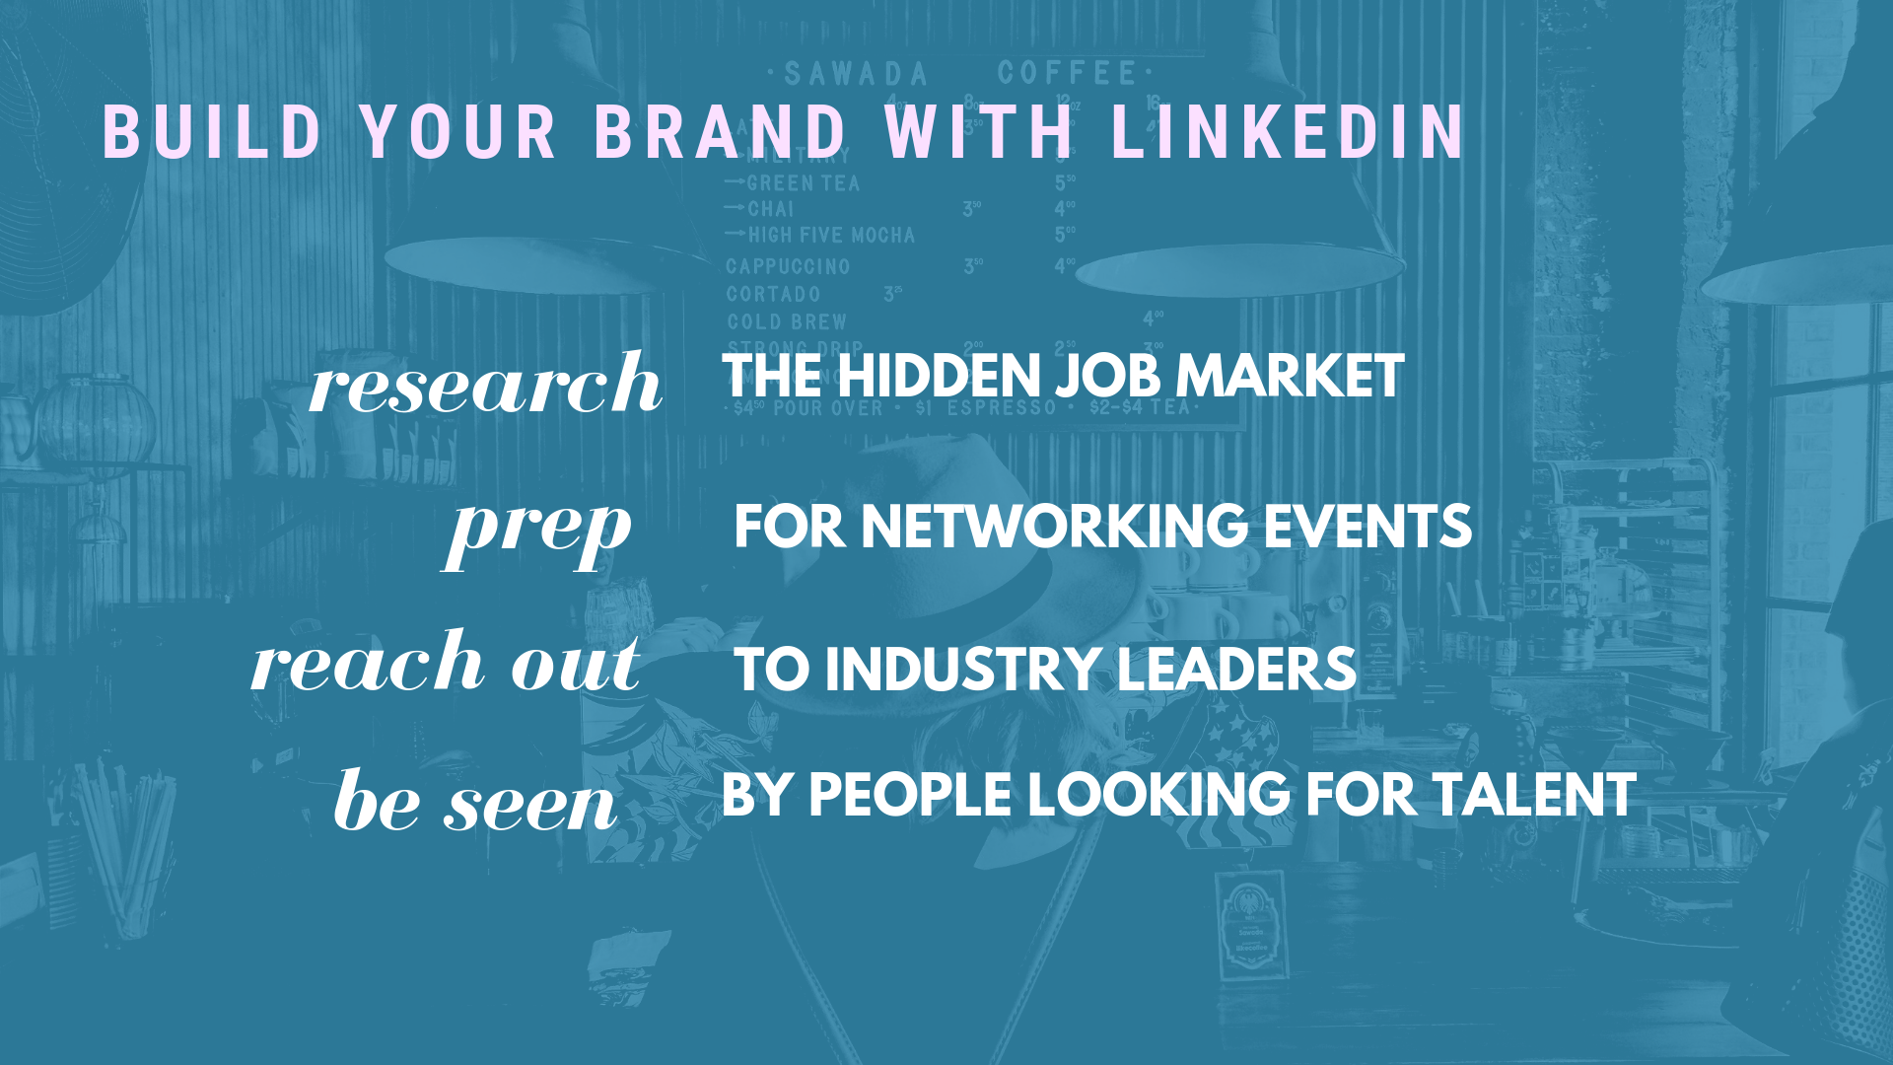
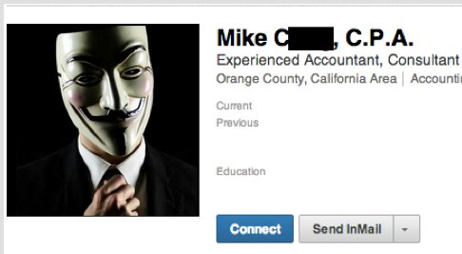
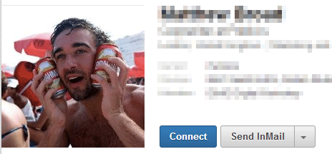
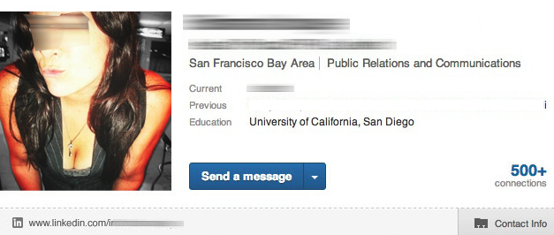
LINKEDIN T TIPS
PROFESSIONAL HEADSHOT
Notes:
Personal Brand: It is important to always keep your audience in mind when using your Linkedin. The way your profile is set up, the things you post and share are all factors that play a role in the way you will be viewed by your audience.
Customizing URL: Cut the letters and numbers on the link to make your profile URL a cleaner look.

Slide 15


Slide 16
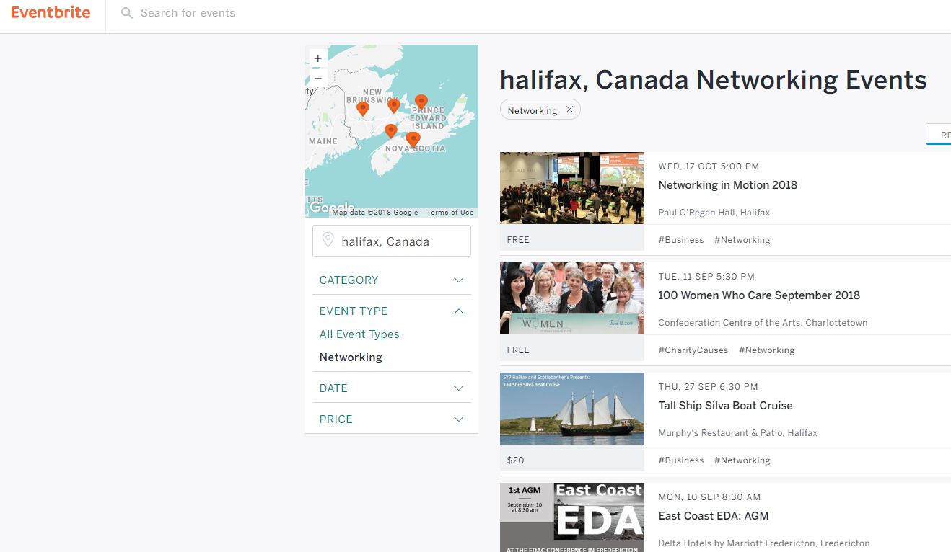
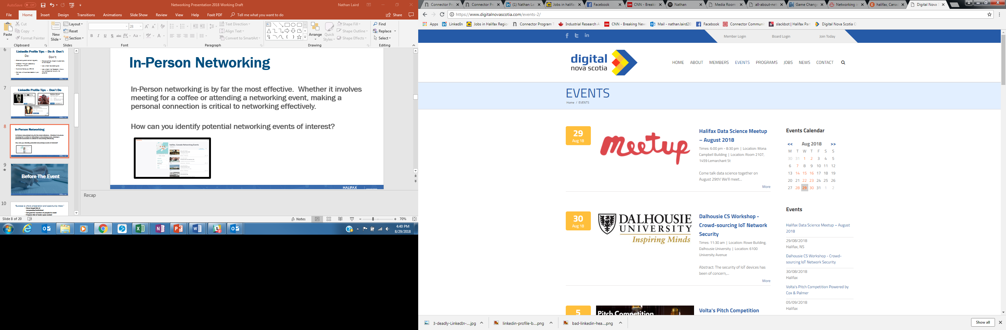
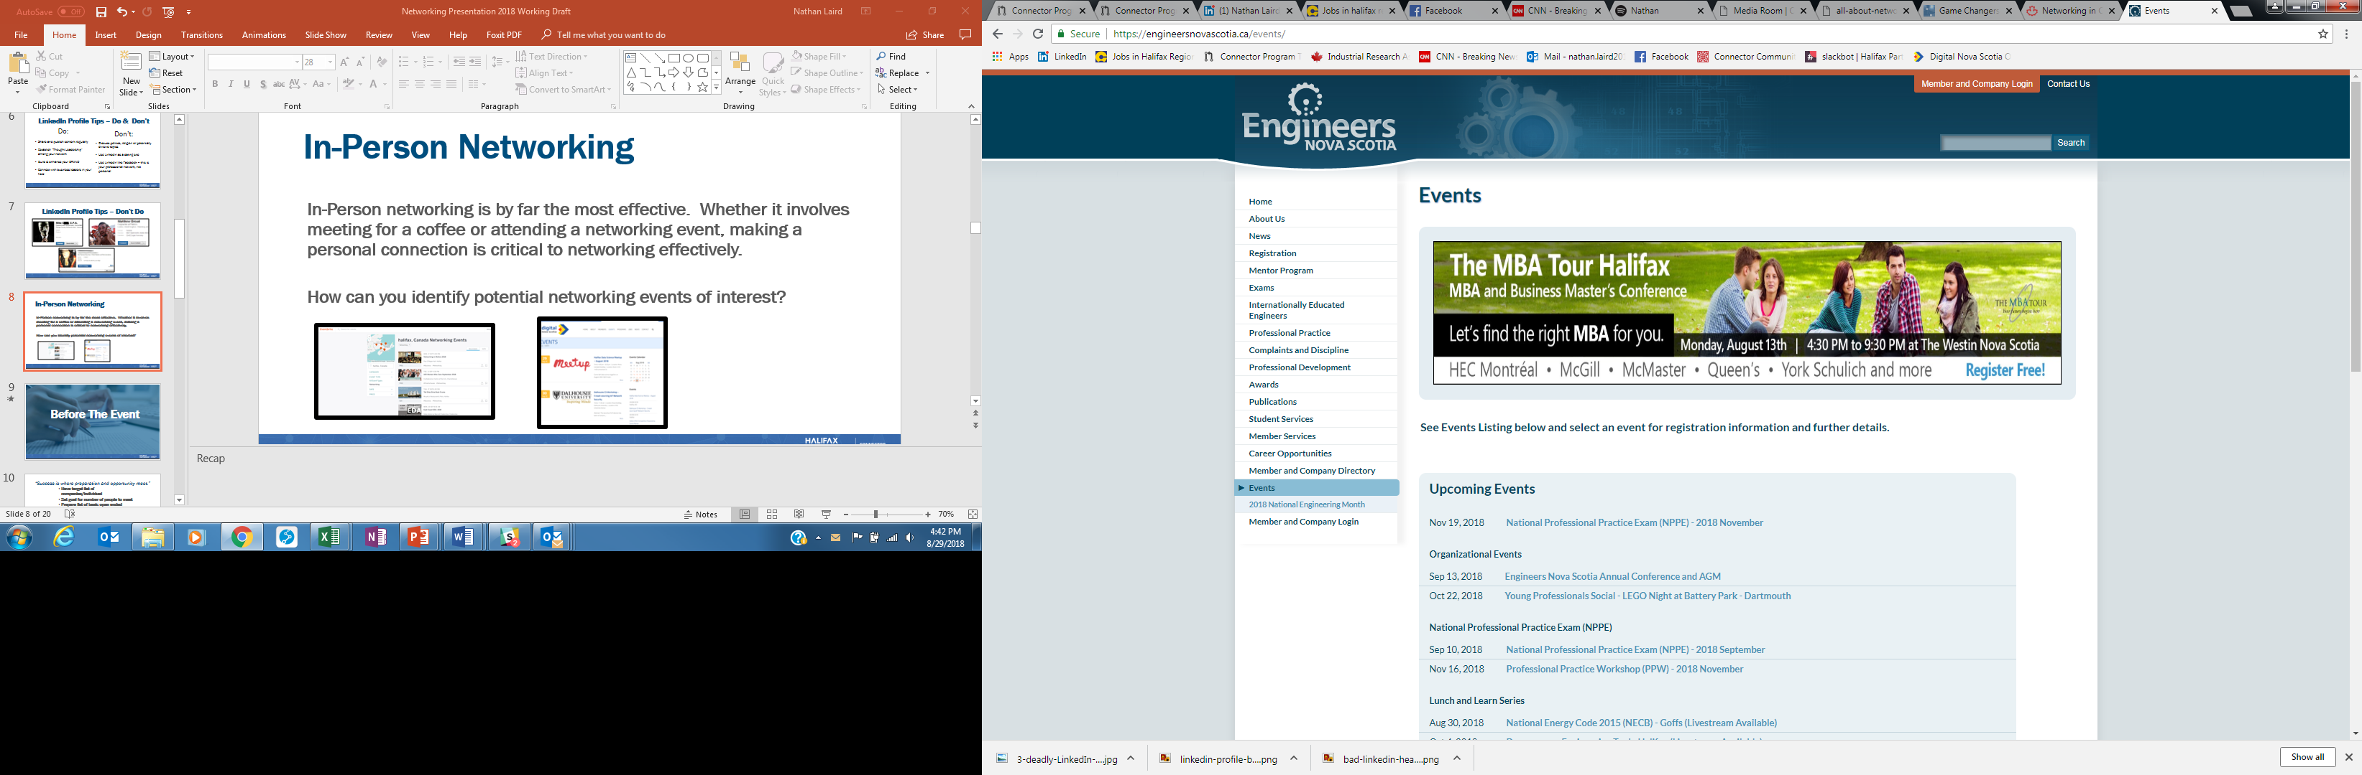
IN-PERSON NETWORKING EVENTS
    In-Person networking is by far the most effective. Whether it involves meeting for a coffee or attending a networking event, making a personal connection is critical to networking effectively.
    How can you identify potential networking events of interest?

Slide 17
IN-PERSON NETWORKING
  Before The Event
Notes:
Discover opportunities
Upcoming short-term projects, volunteer opportunities, conferences, etc.
Tap into the hidden job market
A significant number of jobs are never posted, but rather filled through people leveraging their personal networks
Grow your professional network
Recruiters typically spend about 10 seconds browsing your resume, and having a connection at a given company can help move your resume to the “interview” stack

Slide 18
“Success is where preparation and opportunity meet.”
Have target list of companies/individual
  Set goal for number of people to meet
Prepare list of basic open ended questions (include examples)
  Be prepared to speak about your background, understand personal selling points
  Psychology of networking events
  Dresscode/First Impression/Branding
  Body Language
  Breath mints
  Business cards easily acceptable
Notes:
This quote is attributed to Roman philosopher Seneca aka Seneca the Younger, reminding us that we own our own luck. Luck isn’t just about being at the right place at the right time, it’s also about being open to and ready for new opportunities.

Slide 19

BUSINESS CASUAL & BUSINESS PROFESSIONAL
Notes:
Personal Brand: It is important to always keep your audience in mind when using your Linkedin. The way your profile is set up, the things you post and share are all factors that play a role in the way you will be viewed by your audience.
Customizing URL: Cut the letters and numbers on the link to make your profile URL a cleaner look.

Slide 20
IN-PERSON NETWORKING
  During The Event
Notes:
Discover opportunities
Upcoming short-term projects, volunteer opportunities, conferences, etc.
Tap into the hidden job market
A significant number of jobs are never posted, but rather filled through people leveraging their personal networks
Grow your professional network
Recruiters typically spend about 10 seconds browsing your resume, and having a connection at a given company can help move your resume to the “interview” stack

Slide 21
HOW DO YOU…
Approach others?
Start a conversation?
Make a genuine connection?
Swap contacts and exit?
Remembering names during conversation
Approach someone having a conversation
Keep it professional…. don’t ask for date

Slide 22
TIPS FOR SUCCESSFUL IN-PERSON NETWORKING
Avoid just speaking to friends and colleagues
Avoiding discussing politics and religion
Avoid negativity
Push yourself out of your comfort zone – don’t be intimidated
Don’t be a card spammer or card collector
Maintain eye contact
Ensure a two-way conversation, be genuinely interested
Match handshake
Breath mints
Eating and Drinking at events
Keep one hand free
How long in general to stay with one person

Slide 23
“At the end of the day people won't remember what you said or did, they will remember how you made them feel.” – Maya Angelou
  Keep it positive
  Listen
  Be interested
  No close talking/respect space

Slide 24
IN-PERSON NETWORKING
  After The Event
Notes:
Discover opportunities
Upcoming short-term projects, volunteer opportunities, conferences, etc.
Tap into the hidden job market
A significant number of jobs are never posted, but rather filled through people leveraging their personal networks
Grow your professional network
Recruiters typically spend about 10 seconds browsing your resume, and having a connection at a given company can help move your resume to the “interview” stack

Slide 25

FOLLOW-UP OR FAIL!
  Connect on LinkedIn (NOT Facebook, etc)
  Send an email to follow-up and share contact details.
  Suggest a coffee meeting to have a further discussion
  If you don’t get a response quickly, DO NOT continue to message. Be patient. After about a week, follow up again with a gentle tone.
  Nurture your network, build your brand, and establish “thought leadership” through the material you post/share on LinkedIn.
Do the following within 2-3 days of the event:
Notes:
FOLLOW-UP OR FAIL
Business Cards – Email/LinkedIn 1-3 days after the event. Make notes on the back of the business card. Remind them what you spoke about. If there was a genuine connection you may want to ask to meet for coffee, or you may leave it at “It was great to meet you, I look forward to seeing you at future events”. Perhaps in a few months you want to be connected to that company, and since you already made that initial connection, the doors are open to asking.
NURTURE YOUR NETWORK
How do you stay connected after you added them on LinkedIn, met them for coffee, and thanked them for the advice?
Leverage professional social media sites like LinkedIn and twitter. Engage with your network.

Slide 26
Opportunities for Networking
industry associations
Reconnect with your high school/college/university
Social media
Chamber of commerce, board of trade
Receptions, gatherings, parties, doctor’s office, store line-ups, etc.
Volunteer with your
  Church
  Kid’s sports team
  Community committee or service group

Slide 27
Northern Connector Program
Putting local talent directly in
touch with community and
business leadership to build their
professional network, connect
with career opportunities,
and stay in their community.

Slide 28



How does the Program work?
Match
The Connectees will be matched based on industry experience, professional backgrounds, or the Connectee’s interest in a specific industry. Once the connection has been made, an introduction email is sent to the Connector and Connectee to setup a meeting.
Connect
Once the match has been made, the connector and the Connectee will meet face-to-face to discuss things like; industry backgrounds, skills and areas of expertise, industry related news, current market demands, and hidden job opportunities in the community.
Refer
Connectors are asked to refer the Connectee to a minimum of three people in their network, and then each of these people are asked to refer the Connectee to three more. These referrals may be potential employers, influential leaders within their industry or other people who will benefit from meeting with a skilled professional.

Slide 29
Program Benefits & Outcomes
For Connectees:
For Connectors:
Build a professional network
Access to local talent
Pre-screening before hiring
Learn about the local job market
Enhanced networking skills
Opening doors for young professionals
Significantly improved likelihood of finding relevant and meaningful employment
Knowing you are opening doors for people and helping them succeed in the Northern Nova Scotia region

Slide 30
Program Benefits
Business leaders connect with pre-qualified talent
Graduates/newcomers gain professional industry contacts increasing their chance of meaningful employment
Build brand awareness about your organization
Stay up-to-date on programs and hiring incentives

Slide 31

Graduate to Opportunity
Employer incentive to hire and retain educated new grads in Nova Scotia.
Eligible employers receive 25% of Year 1 salary (35% if the grad identifies in a designated diversity group) and12.5% of Year 2 salary
Employer Eligibility
Small businesses, start-ups, social enterprises, non-profits & registered charities
Graduate Eligibility
Must have graduated from a recognized post-secondary institution in the last 12 months
(excluding registered trades)
Job Requirements
Employer must offer a full-time permanent position paying a minimum of $30,000/yr.
Employer and job must be based in Nova Scotia

Slide 32
  DISCOVER opportunities
  UNCOVER the hidden job market
  GROW your professional network
Notes:
Discover opportunities
Increase your chances to find out about job openings that are otherwise not advertised
Upcoming short-term projects, volunteer opportunities, conferences, etc.
Discovering opportunities outside your industry. For example if you’re in PR and only look at events involving PR agencies or targeting a PR crowd, you may lose opportunities that could arise in IT or Finance related events. Many IT companies and financial institutes have a PR/marketing department, so there could be a missed opportunity there.
Tap into the hidden job market
A significant number of jobs are never posted, but rather filled through people leveraging their personal networks
Grow your professional network
Provides you with invaluable opportunity to best prepare you for your career goals
Gathering information about your field or industry
Networking is a mutual process – you never know when your skills and resources can prove to be beneficial to others in your network
Recruiters typically spend about 10 seconds browsing your resume, and having a connection at a given company can help move your resume to the “interview” stack
Networking should also be approached as an ongoing process that takes time and nurturing, and not something you do just when you are looking for a job.

Slide 33
THANK YOU
www.northernconnector.ca
mberrigan@northnsconnector.ca
902-449-1273

