Slide 1


Learning Exchange Halifax, Nova Scotia October 30-31st, 2017
Notes:
Robyn & Sasha

Slide 2
Introductions & Communities Overview
Notes:
Robyn –
Welcome, importance of the Gala
please introduce yourself and give a brief overview of your Connector Program.

Slide 3
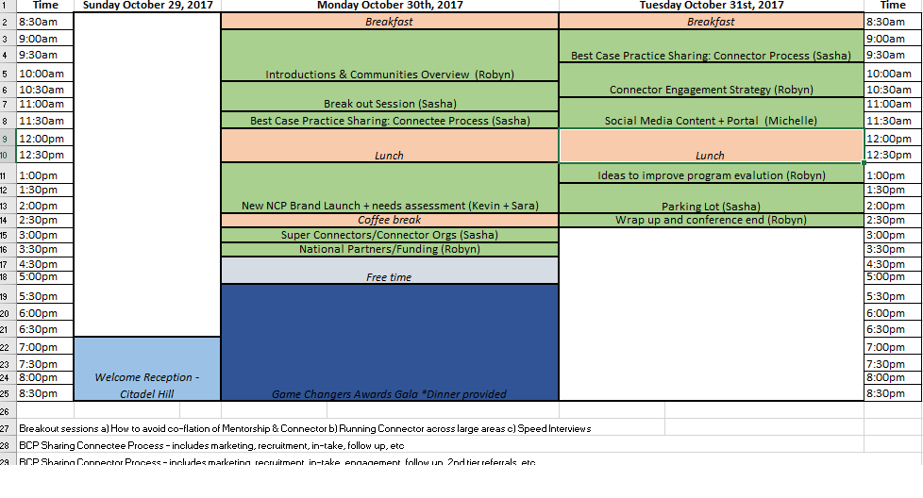
Notes:
Sasha

Slide 4
Breakout Session
Pick one of three:
How to avoid co-flation of Mentorship and Connector Programs – Jasmine from OSICO
Running Connector across large geographical areas – Vibha from ACCES Employment
How to run effective Speed Interviews – Renee from Halifax Partnership
Notes:
Sasha: This breakout session will be a best case practice sharing from some our communities who have much experience in these topics. Please pick one you’d like to learn more about. We’ll have people taking notes at each table and that knowledge will be shared with everyone, in case you are torn between topics!
Elena: share questionnaire in mentorship session

Slide 5

BCP’s for Connectee Process
Marketing/promotion
Recruitment
In-take and expectation setting
Follow up
Additional support
Other BCP’s?
Notes:
Sasha

Slide 6

Lunch!

Slide 7
Brand Launch & The Art of the Possible – Group Discussion
Notes:
Sasha – so before I flip the slide, what comes to mind when you think of a Connector Organization? A Super Connector?
Great feedback – let’s start with Connector Orgs

Slide 8
The National Connector Program provides powerful networking opportunities. In a structured square, numerous points of contact are made and shared between each other—just as connectees move from connector to connector.
All of this happens while their web of networks continually expands, helping to get a foothold in the workforce. The intricacies of the icon share similarities with how complex and free-flowing the connections are within the program and within your community.
Program?
Rationale

Slide 9


Slide 10


Slide 11
What’s working well in your program?

Slide 12
What are the challenges you face in reaching newcomers and connectors?
Notes:
WHAT ARE SOME CHALLENGES YOUR COMMUNITY IS FACING?
Recruiting newcomers?
Recruiting Connectors?
Retaining Connectors?
Promoting the program?

Slide 13
How are people finding out about your program?
Notes:
HOW ARE PEOPLE FINDING OUT ABOUT THE PROGRAM IN YOUR COMMUNITY?
Word of Mouth
Social Media
Organic internet search
Immigrant settlement programs
Welcome package

Slide 14
What supports do you need to grow your program?

Slide 15
What does the newcomer journey look like?

Slide 16
Touchpoints
Notes:
What are some touchpoints along this journey where we can reach newcomers?

Slide 17

Coffee Break

Slide 18
CONNECTOR
ORGANIZATIONS
& SUPER CONNECTORS
Notes:
Sasha – so before I flip the slide, what comes to mind when you think of a Connector Organization? A Super Connector?
Great feedback – let’s start with Connector Orgs

Slide 19
CONNECTOR ORGANIZATION
Demonstrates leadership in values of diversity and inclusion, also reflected in their workforce
Implements Connector into their workplace culture, and actively promotes the program.
Maintains at least 5 active Connectors and has met with at least 12 Connectees combined in the last year
Participates in Connector events such as Speed Interviewing/Networking.
Notes:
Sasha

Slide 20
ROUNDTABLE CONVERSATION
How can we help large organizations implement Connector Organizations?
Notes:
Sasha – discuss at your tables for 10 mins, and then we’ll share the key points from each table.

Slide 21
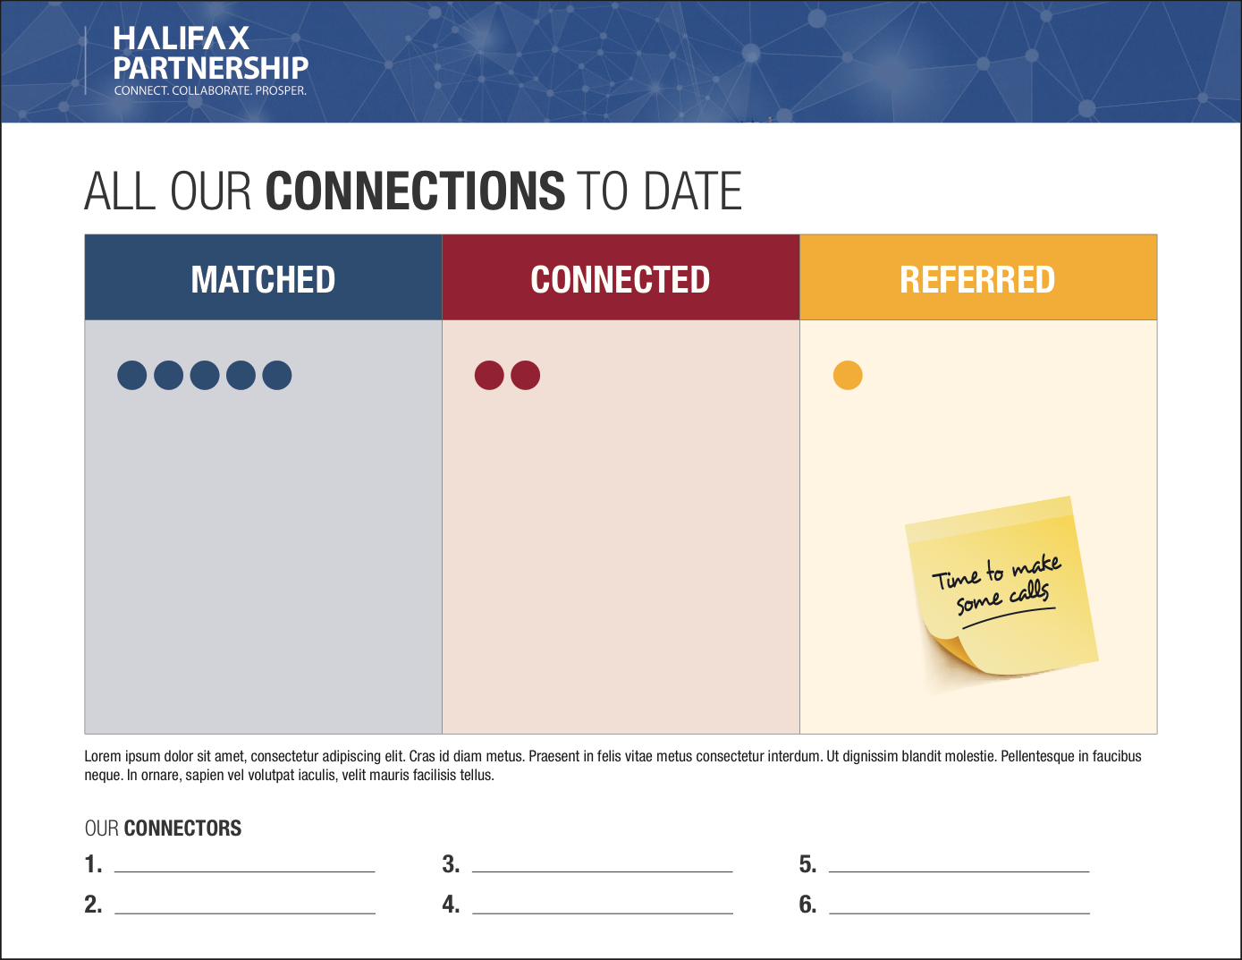

Slide 22


Slide 23


Slide 24


Slide 25


Slide 26


Slide 27


Slide 28

Notes:
NEW IMAGE

Slide 29


Slide 30


Slide 31
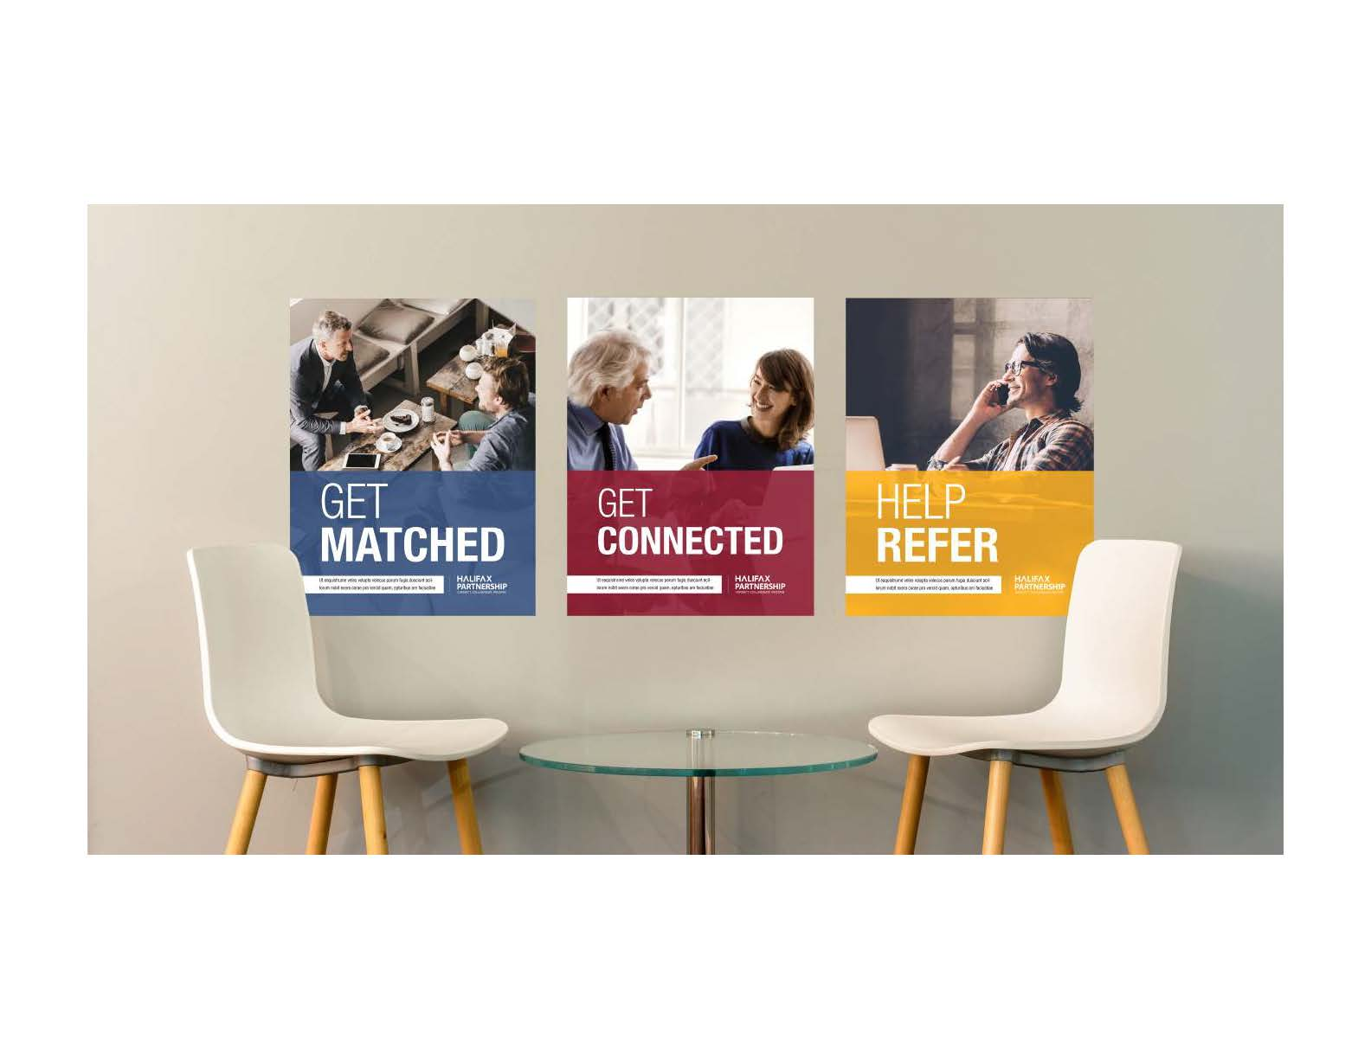

Notes:
NEW CENTER POSTER

Slide 32
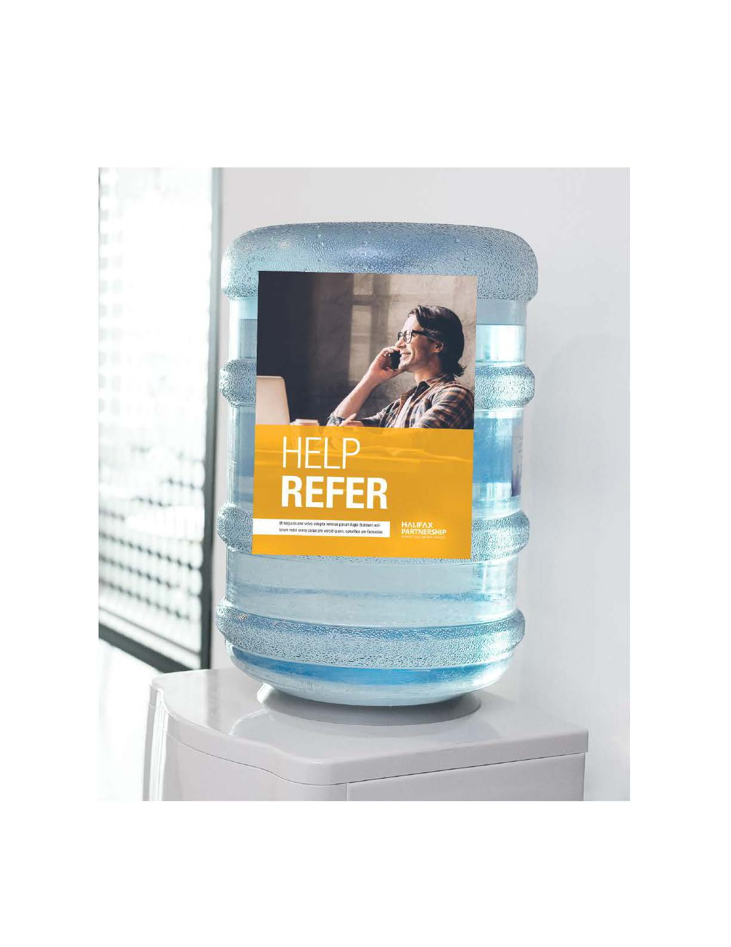

Slide 33


Slide 34



Notes:
YELLOW PIN CHANGES TO REFER ICON

Slide 35


Slide 36


Slide 38

SUPER CONNECTORS
A Super Connector is someone who meets with more than 3 connectees a year and consistently makes referrals, and/or is someone who goes above and beyond to help their connectees. (i.e.- take them to networking events, get them a job in their company, etc.).
Notes:
Sasha

Slide 39
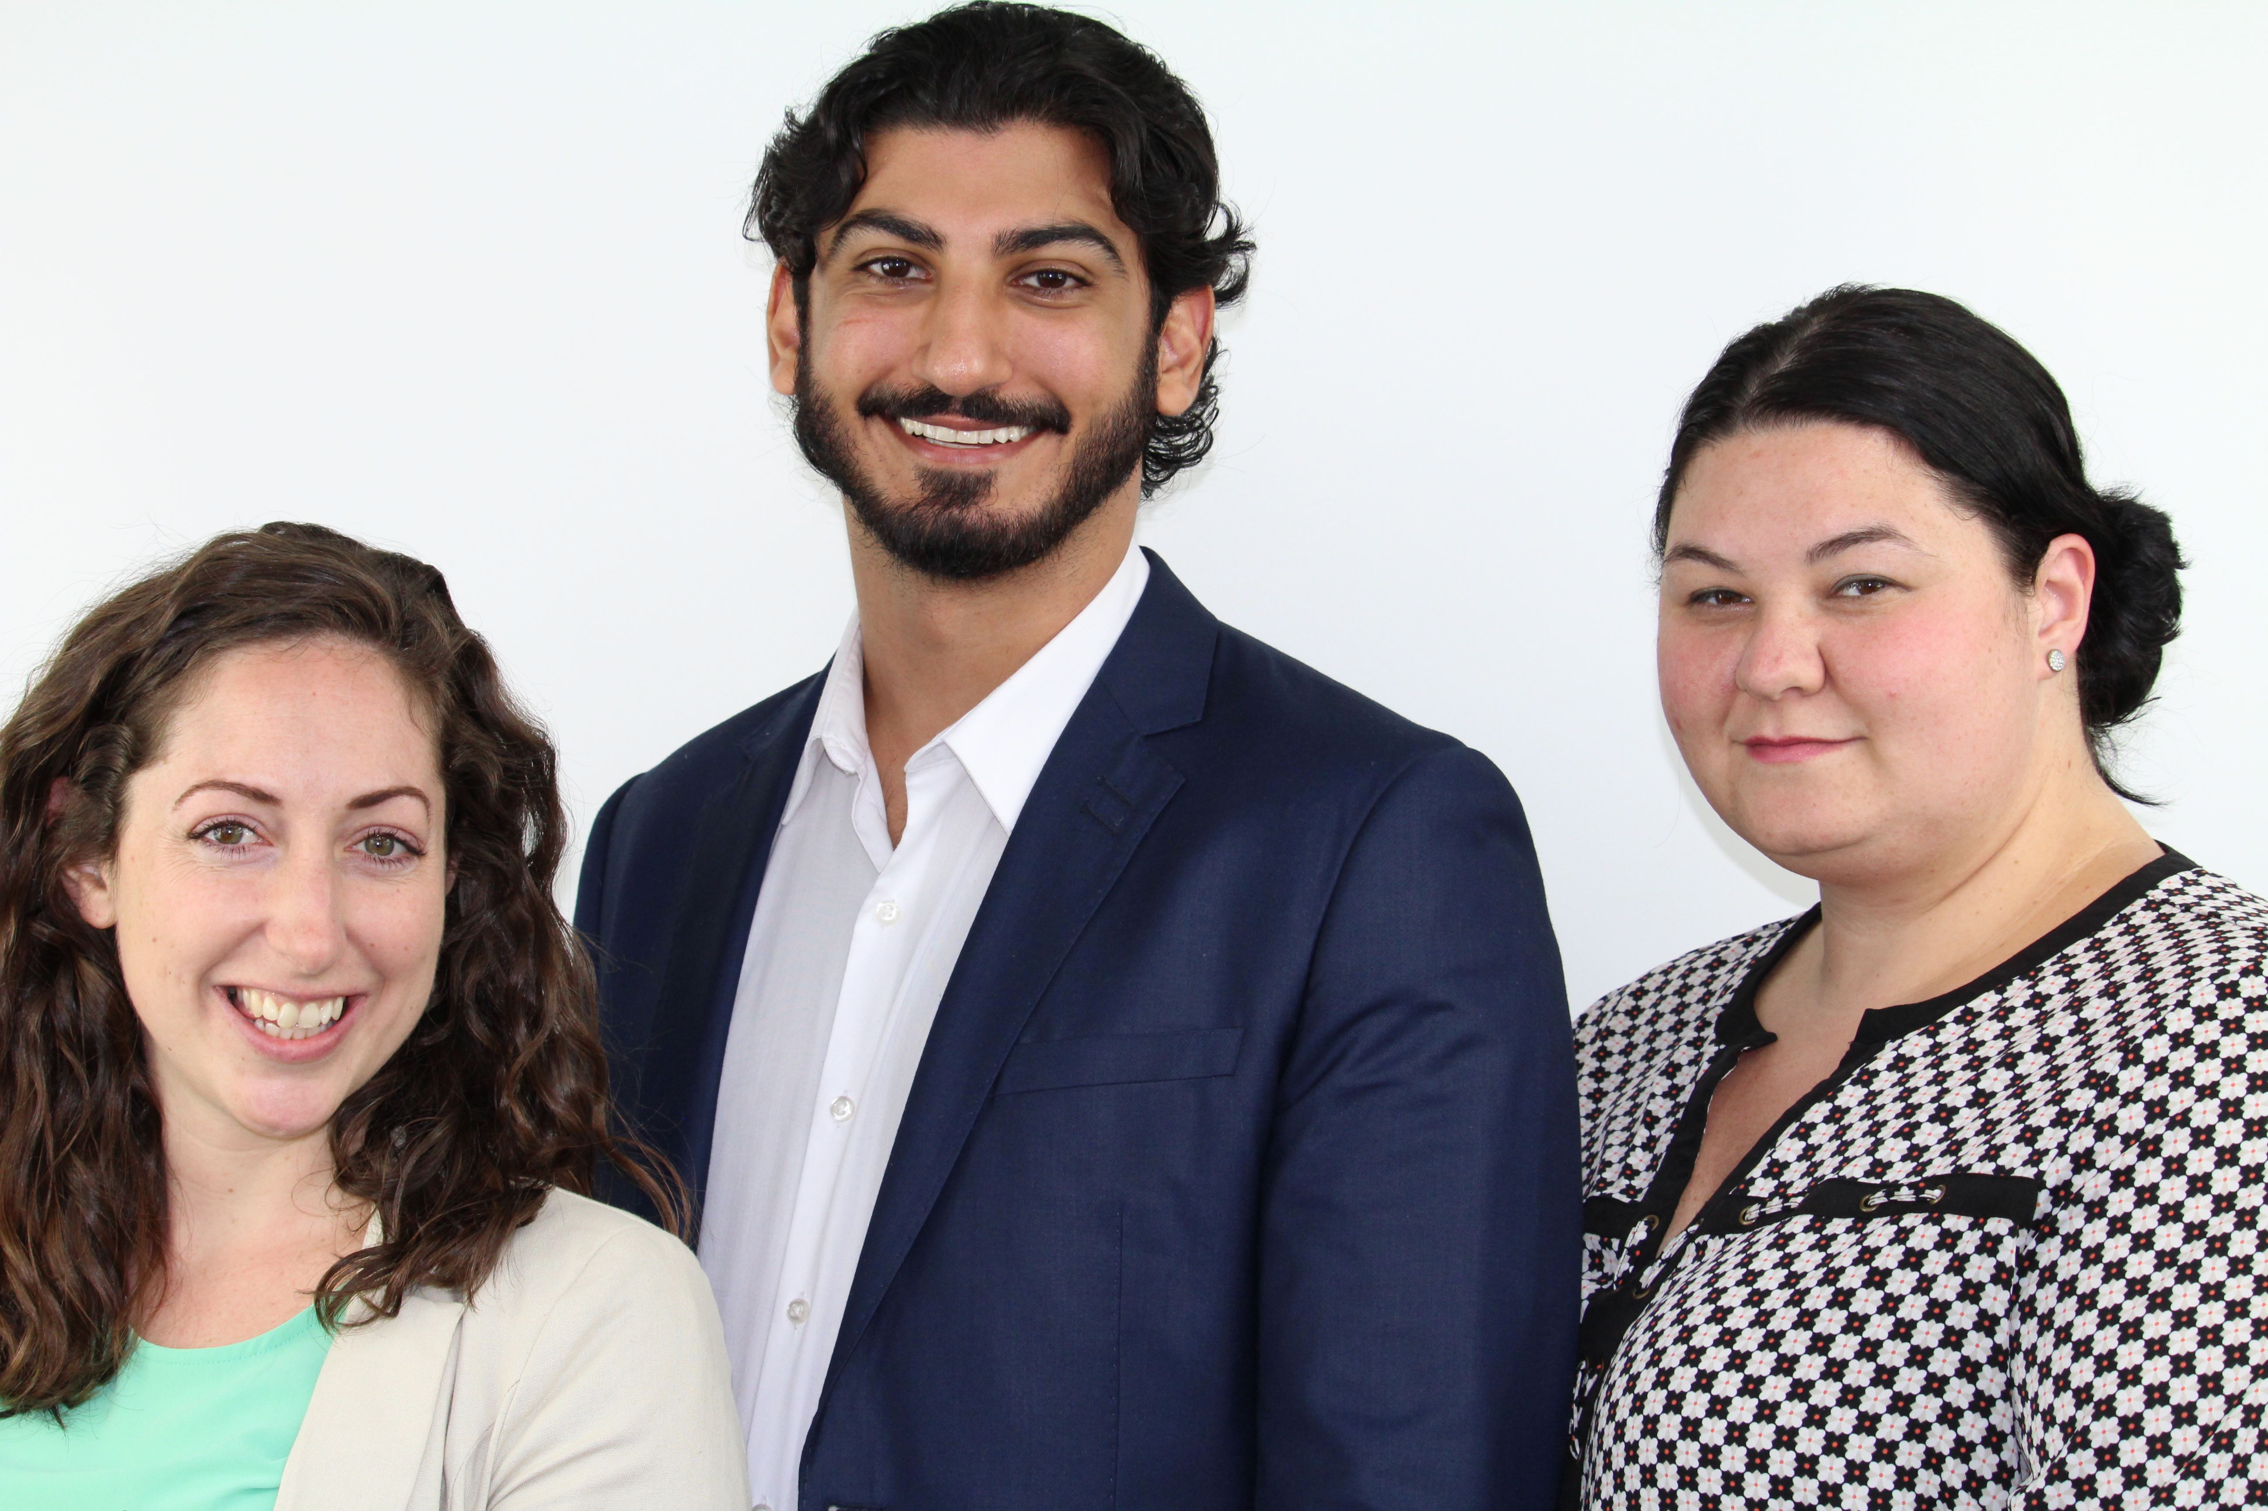
Upcoming project – Super Connector Campaign
National promotional campaign for Connector
Profiling 10 “Super Connectors” from across Canada
Submit potential connectors for the campaign
Stay tuned – January 2018!

Slide 40
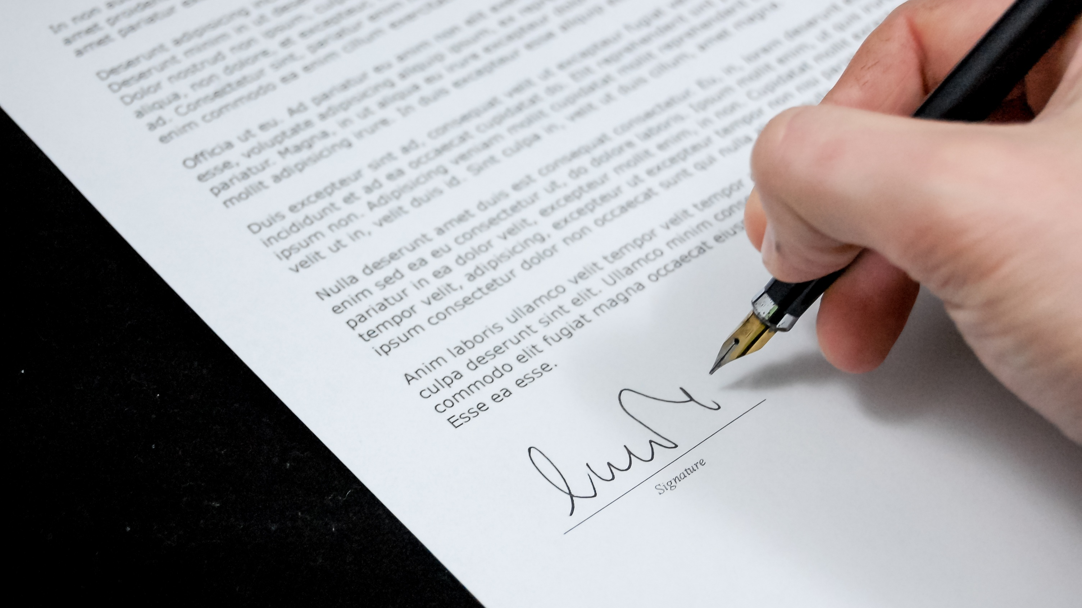
NCP Partners & Funders
Notes:
Robyn

Slide 41
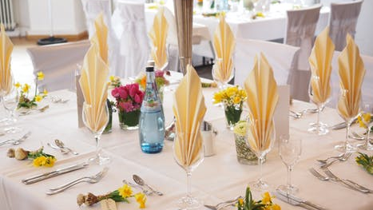
Game Changes Gala
Tonight! Cocktail Reception starts at 5:30pm in the Commonwealth Ballroom in this hotel. Dinner served at 6:30pm.
Notes:
Sasha
Tomorrow in this room for breakfast 8:30am

Slide 43

BCP’s for Connector Process
Marketing/promotion
Recruitment
In-take and expectation setting
Follow up
Engagement
2nd Tier Referrals
Other BCP’s?
Notes:
Sasha

Slide 44
Connector Engagement Strategy
Notes:
Robyn

Slide 45

Social Media Content & Website
Notes:
Michelle

Slide 46
Lunch!

Slide 47

Program Evaluation
Ideas
Notes:
Robyn

Slide 48

Parking Lot
Questionnaire
NCPAP
Notes:
Sasha

Slide 49
Wrap up & End
*Group photo!!!!!
Notes:
Robyn

Slide 50
Thank you for coming!
Notes:
Robyn

