Slide 1


Marketing 101

Slide 2
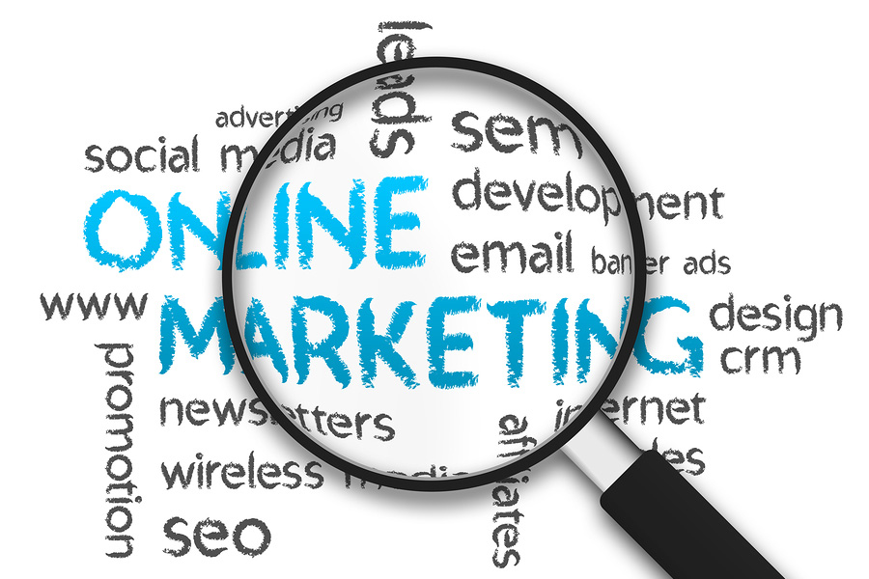
WHY ONLINE MARKETING
Cheap
Wide Range
Close relationship
Higher ROI
Measurable

Slide 3
Content Marketing

Slide 4
Marketing 101
CONTENT MARKETING
Storytelling that connects with your audience
Grow awareness of your brand or business
Recruit advocates for your brand
Increase and improve your search engine rankings (SEO) which drives more people to your website
Notes:
Content Marketing is an opportunity for you to create the type of content that people want.
The marketing element is a strategic way of creating content with the aim of building the Connector brand and educating your audience to the benefits of being a Connector and a Connectee (your services).
Stories are 22 times more memorable than facts and figures, and brain activity increases to 5 times higher when a person is consuming information through a story (E.g. sharing success stories on social media, or a new Connectors story).
Content Marketing is not just about promoting your brand, it’s about forging a long-term relationship of trust and familiarity with people.
To drive more people to your website, you can be strategic about infusing high-ranking keywords in your content so your website climbs up in Google search rankings. These keywords should be used sparingly within your content, not sprinkled on every sentence you write.

Slide 5

We need to connect with our audience through stories people love!
Connectors
People want to make a difference in their community
Connectors
Organizations have hiring needs
Relevant
Addresses Needs
Connectees
People need to build their professional network if they want to increase their chances landing a job
Personalized
Includes a CTA
Valuable
Presents Solution
Recruiting
Outmigration
Labour market integration
Notes:
Relevant: If you can see why a customer would engage with a piece of content, or how it helps drive your business agenda, then it may not be worth creating. It’s good to sense check your content against your business objectives and audience expectations.
Addresses Needs: It’s also important to create content that addresses the buyer’s needs or interests. They will have questions about why they should go with your offering and those questions need to be addressed proactively to help them make their mind.
Personalized: It’s important to create content that is personalized, content that speaks to your audience at that moment and time, that is relevant to their personal outlook on life, or addresses their pain points
Includes a CTA: Effective content always has a call-to-action (or CTA). Your customers and potential audience need to know what action to take when they see your content. Giving people a clear CTA allows them to understand exactly what you’re selling or promoting and brings them a journey through the conversation funnel towards purchase or action
Valuable: If your content is useful, educational, or entertaining to your audience in some way, it is valuable to them and will resonate with them and they will be more likely to convert or even promote your content
Presents Solution: Your content must demonstrate that your model is the solution, and that you have a unique selling point (USP). Content that presents a solution to the pain points of your audience will build reputation as a brand that is reliable and can be trusted.

Slide 6

A content marketing strategy is an ever-evolving plan that outlines your content marketing goals and target audience.
Content Marketing Strategy
Sets out the objectives and scope of your project
Determines the content needs of your target audience
Should always be tweaked and modified
Defines user journey, content formats, and content styling
Aligns to business objectives

Slide 7
Email Marketing

Slide 8
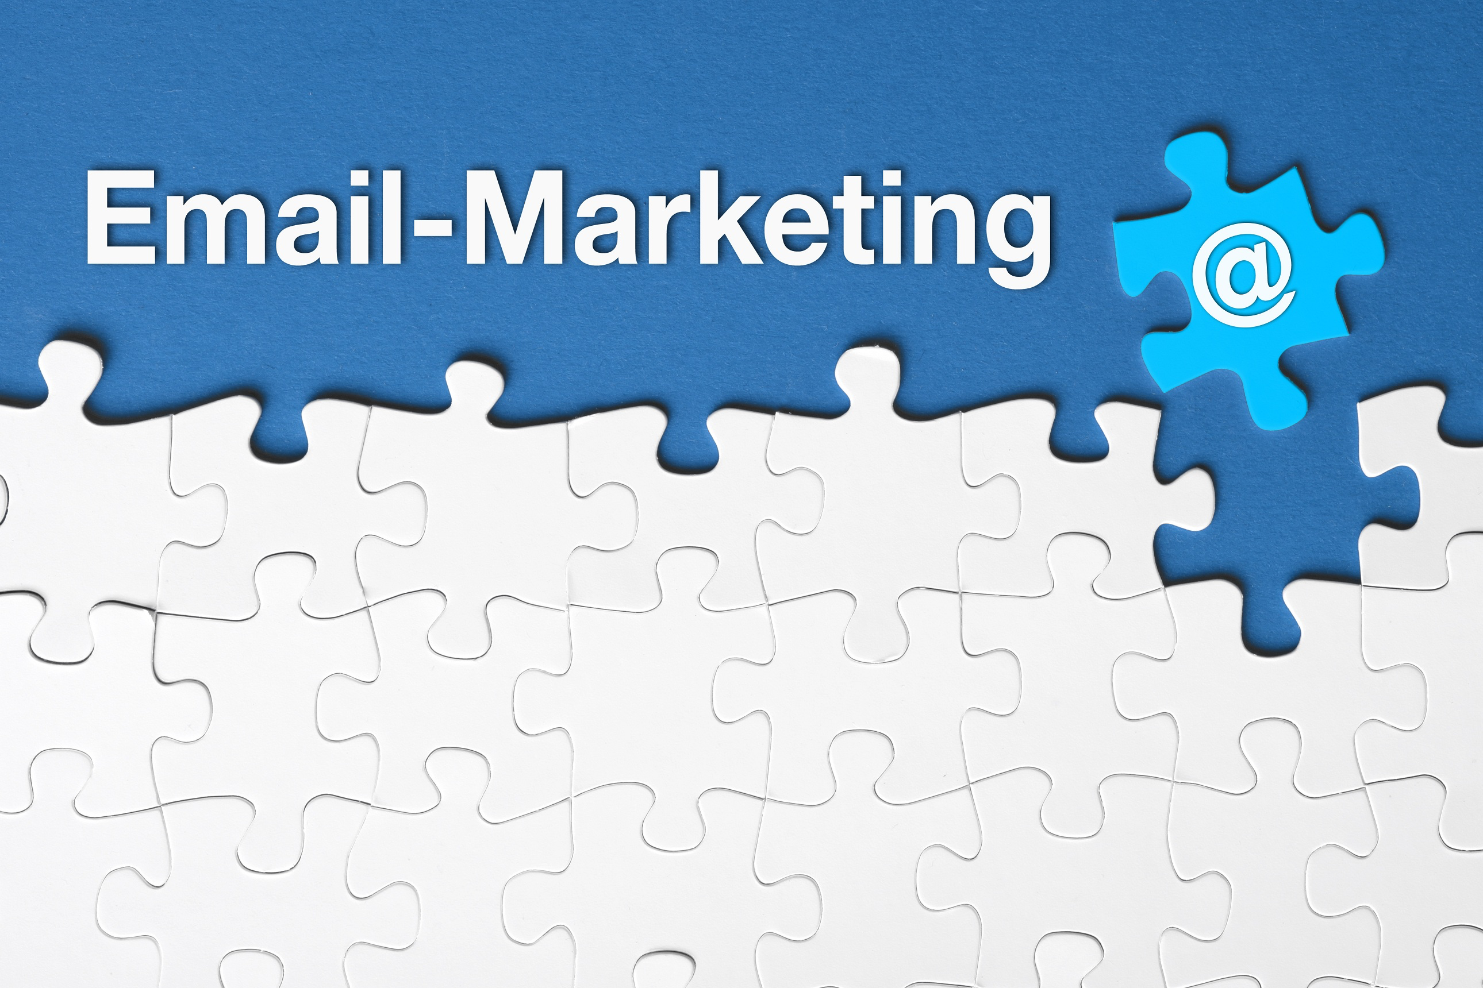

Slide 9
EMAIL MARKETING TIPS
Email is the most popular activity on smartphones among users age 18-44
Email marketing has an ROI of 4,300%
Over half of businesses achieve over 10% of total sales through email marketing
Over 70% of mobile purchasing decisions are influenced by promotional emails

Slide 10
EMAIL MARKETING TIPS
Best Tools: MailChimp, Constant Contact
Short and Visual
Use mobile friendly templates (64% of decision-makers read their email via mobile devices)
Have good subject lines (1/3 emails are opened based on subject line alone)
For best readership, think: mid-week, mid-day
Notes:
If you use HubSpot to track your emails – meaning tracking who from your Connectors and Connectees open the toolkits you send, you can change your strategy.
You can bold specific words on the email – “it’s important to thoroughly go through the toolkit” or highlight the main points in your email.
You can get creative with your email template and layout on MailChimp to make it more attractive for the reader.

Slide 11
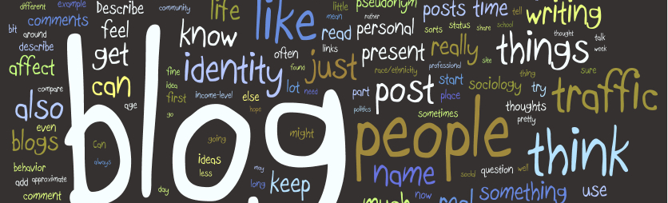
WHY BLOG?
Drives more traffic to your website
It helps convert that traffic into leads (call-to-action)
Gives your business a voice / helps establish authority
Drives long-term results (70% of HubSpot's traffic each month comes from blogs that weren’t published that month)
60% of businesses who blog, acquire more customers than those who don’t

Slide 12
BLOGGING TIPS
Best tools: WordPress, HubSpot
Publish only your best content (think of blogs as $$)
Target your readers with useful content
Invite guest bloggers
Don’t just talk about yourself
Show your personality
Use your blog as a jumping off point for all your content marketing

Slide 13
Social Media

Slide 14
WHY SOCIAL MEDIA?
46% of web users look to social media when making a purchase
3 in 5 small – medium sized businesses say they’ve gained new customers through social media
‘Latest products & information’ is the #2 reason people use social media
Average Twitter user follows five or more brands
Note: pre-populating and schedule content using Hootsuite or CoSchedule will save you a lot of time

Slide 15
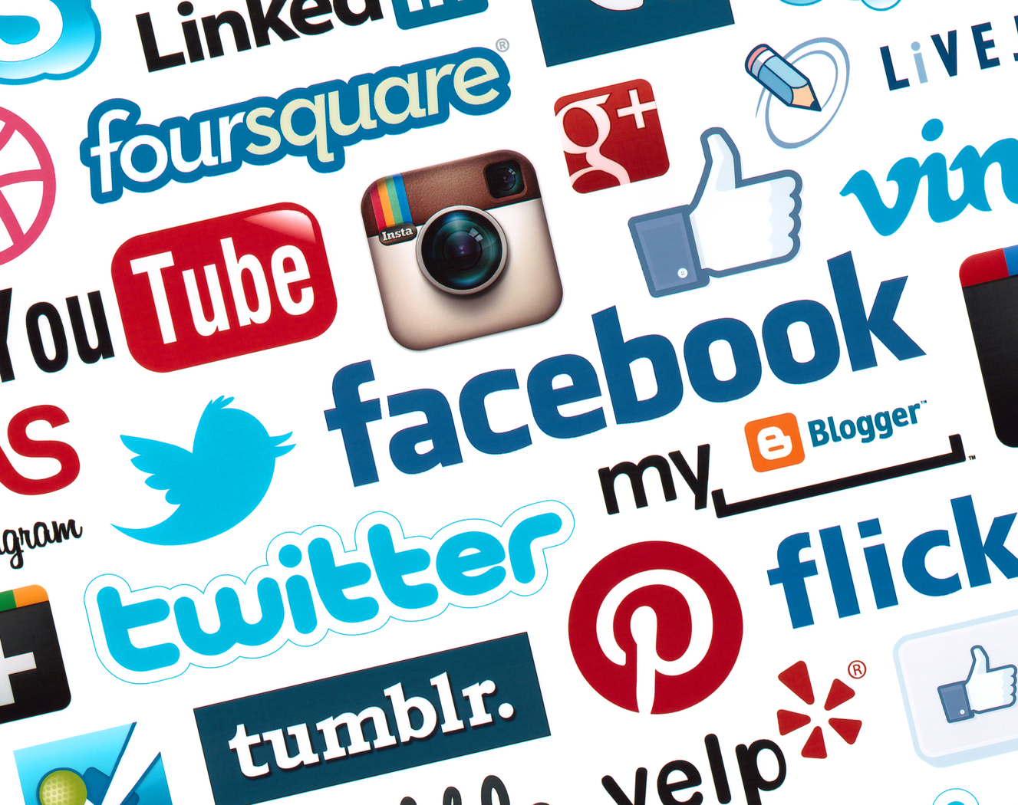
KEY SOCIAL MEDIA PLATFORMS
Notes:
LinkedIn: This platform is focused on building and developing professional connections and professional networking as you know. It’s great for building relationships and fostering affinity groups. It’s great for targeting corporate consumers through paid advertising. Using thought leadership and the right tone is very important.
Facebook: the largest social platform, is a highly effective channel for audience reach. This platforms encompasses all demographics and it’s “sticky” meaning users spend a lot of time on the site – 40 minutes per day, on average and a whopping 2% of all time online.
The free Facebook Insights tool lets you track the results of your Facebook marketing, including ads and organic posts. You can see how many likes you got in the week, how that compares to past measures, and what type of engagement you received (likes, comments and shares) on posts. You can tell which ads drove traffic to your website and more.
Twitter: enables its users to read short posts, called tweets. Part of what differentiates Twitter from other platforms is that it’s very conversational in nature, due to the fast-paced, real-time dimension of its users’ timelines. Hashtags just like Facebook and LinkedIn, makes it a great place to discover content. It’s a great place for participating in events in real time.
YouTube: is the largest video sharing platform in the world. It is where users can watch, like, share, comment on, and upload their own videos. YouTube is great for product reviews, how-to guides and more. Age – 15 – 49 year-olds.

Slide 16
SOCIAL MEDIA TIPS
Best tool: Hootsuite
Don’t be too serious
Be authentic
90/10 Rule
Use the same hashtags (#Connector, #ConnectorProgram) top build consistency and a following
Notes:
90/10 rule: spend 10% of your social media time talking about yourself and the other 90% paying attention and listening to you network. It’s simple human psychology – people love the people who make them feel good.

Slide 17
WEBSITE CONTENT TIPS
Best tool: Google Analytics
Keep content up-to-date
  What is this program?
  How can it help me?
  Why should I trust this organization?
  How do I sign up?
Call-to-action
Don’t use generic emails
FAQs / Recent Success pages
Link back to other online tools

Slide 18
HOW TO MANAGE CONTENT MARKETING
Agree on goals
Create visuals and images
Editorial calendar
  Images/videos/infographics
  Cautiously schedule social media posts
Google Trends / Buzz Feed
Schedule
  Scoop.it
  WordPress
  HubSpot
Content promotion, (re)- distribution, and re-purposing
Social Media | Blogs / Emails
Morning – 30 minutes | Monday – Outline ideas
Afternoon – 30 minutes | Tuesday – Write your piece
30 minutes | Wednesday – Embellish (pics, videos, links etc.)
10 minutes | Thursday – Proofread and PUBLISH!
Notes:
Remember, in an ideal world, every piece of content that your team creates has a purpose. Depending on what your ideal outcome is, you’ll need to work with and manage different team members during the creation and distribution process.
Content promotion, re-purposing and re-distribution: (content created today and be re-purposed in a few months (e.g. a blog turned into a LinkedIn post)
Promotion and re-distribution should be made on email newsletters, blogs, social media your website, etc.

