Slide 1
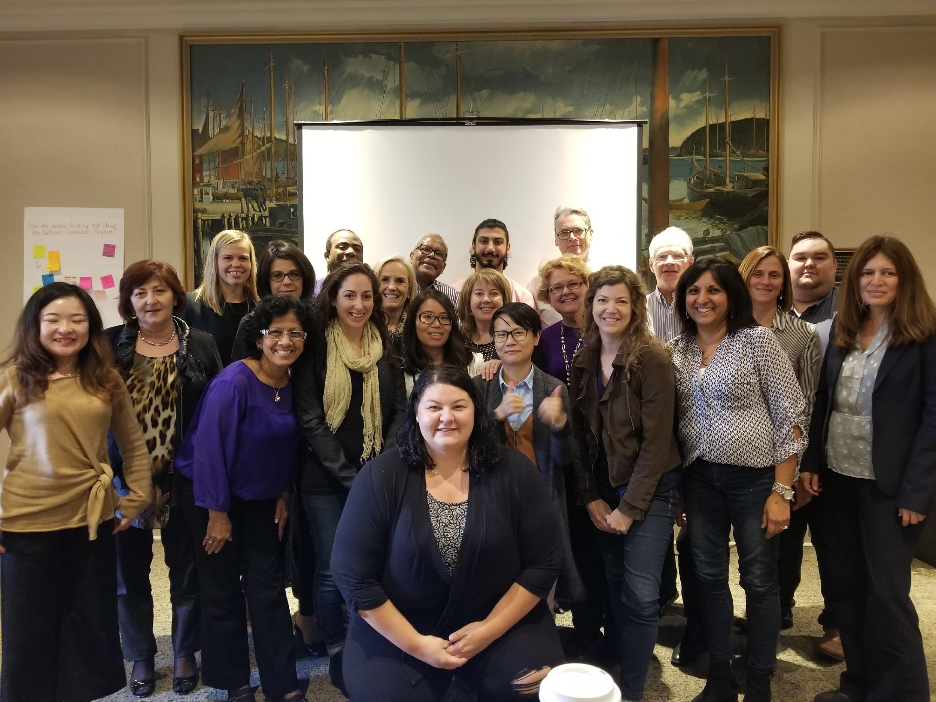

Learning Exchange 2018
Westin Nova Scotian, Halifax, Nova Scotia

Slide 2
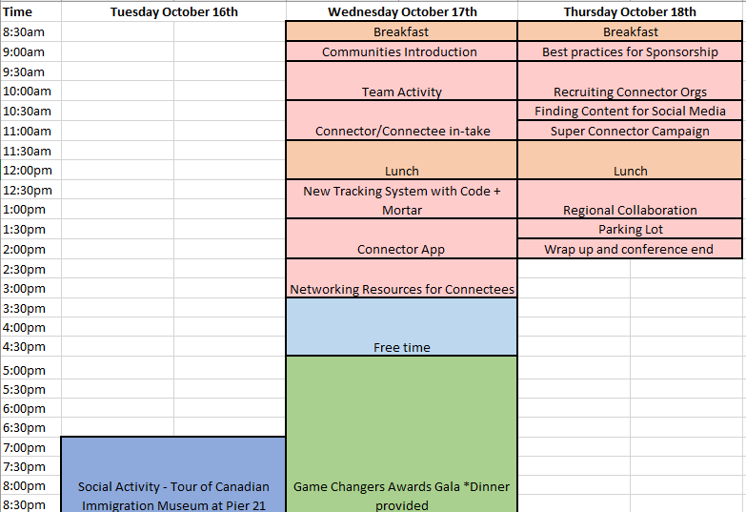
Agenda

Slide 3
Community Introductions
Success Skills Centre
ESREN
ACCES Employment
ONB
Change Agency
KWMC
ERIEC
C.A.R.E
VREN
Halifax Partnership
PEI Network
Thunder Bay CEDC
CRIEC
NL Connector
WREN
CPA Alberta
Cape Breton Partnership
CESC
Lethbridge Family Services

Slide 4

Team Activity
This Photo by Unknown Author is licensed under CC BY-NC-ND

Slide 5
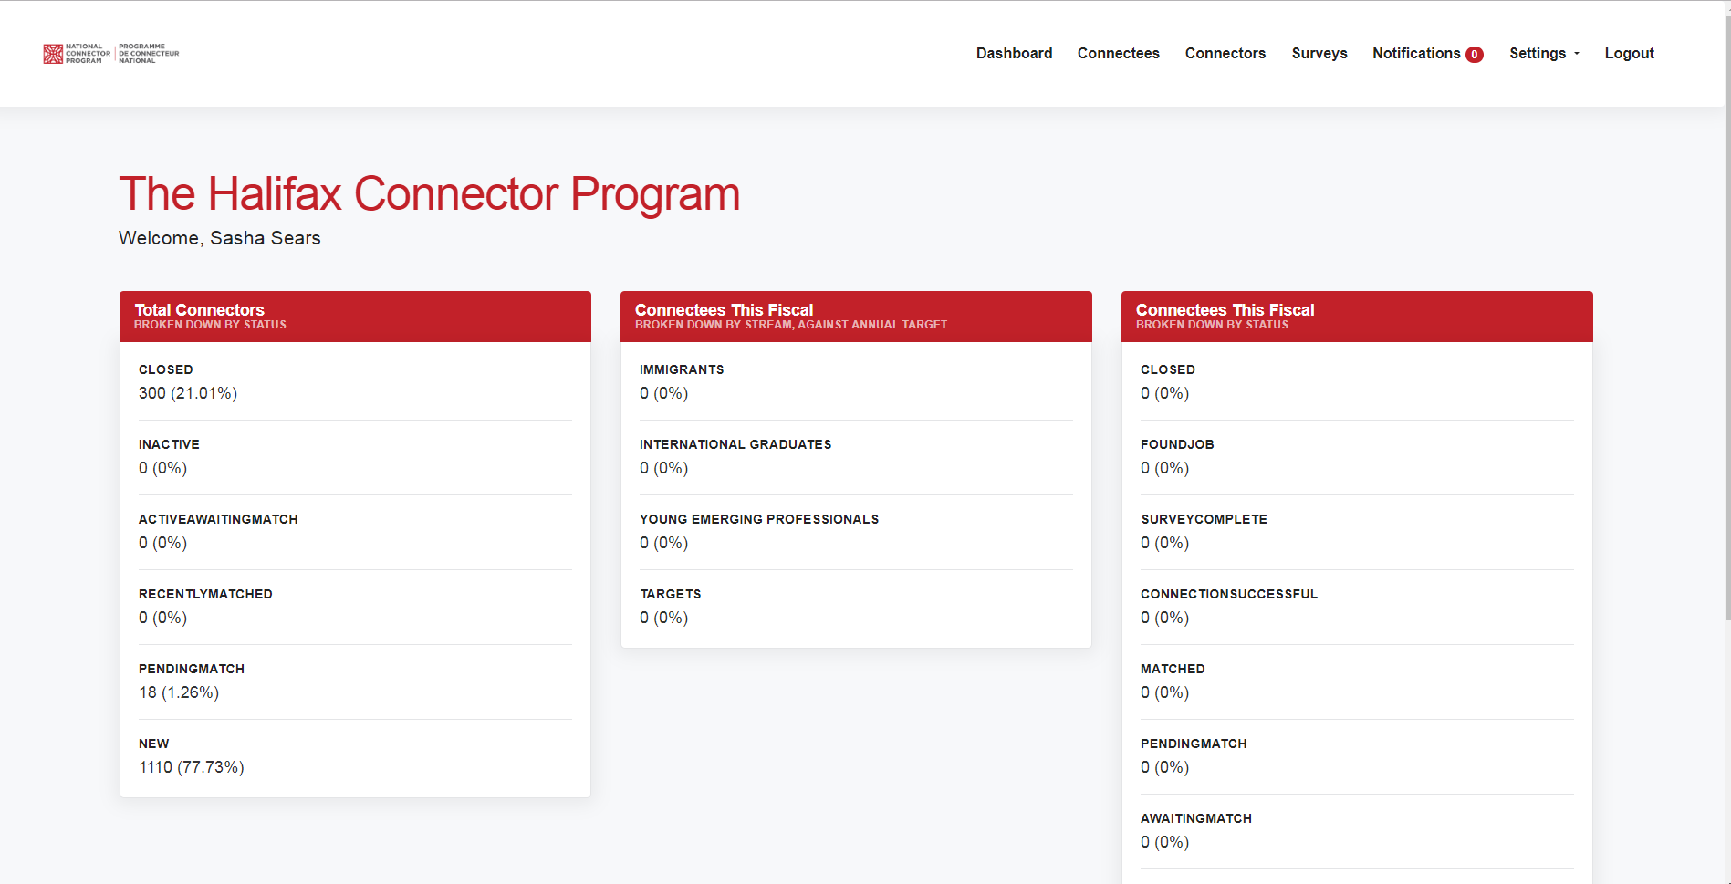
New Tracking System – Code + Mortar

Slide 7


Slide 8


In-take changes for Connectees and Connectors

Slide 9
Connectee In-take changes
Pre-survey to be completed when logging into the tracking system
Consent form to be signed in new tracking system
Automation will move most emails out of your inbox into the system
Connectee will write an introduction instead of resume information
Matching will be based on skill sets, industries, seniority and language
Referral information captured will only be the name of the referral – no contact information
Notes:
Why a pre-survey? Most government funders are moving to an outcomes based model, where evidence is being requested to show impact and measurement of outcomes. This pre-survey as well as the post-survey will allow us to directly measure and track the impact the Connector Program is having on Connectees confidence, networking skills and integration into their communities.
Consent form is to be proactive in ensuring all expectations of the program are clear to avoid any liability, as well to ensure the safety of our participants.
The introduction the Connectee writes can be copied and pasted into your introduction email to save time. Their resume can still also be referenced if you’d like to add additional information.
The new matching algorithm will allow us to make better matches that aren’t only focused on titles or industries. This will also allow us to engage more Connectors based on the frequency they would like.
Referrals are a pain point and this was the best option for a) capturing that a referral was provided and b) still allows us to use this as a sales pipeline, with some small tweaks.

Slide 10
Connector In-take Changes
In-take meetings need to ask Connector preferred industries, skill sets, seniority level. To be added into system when adding new Connector
Connector will be sent email consent form – “click to consent”
Connector will be sent post survey automatically
Post survey will determine when a Connector is ready to be matched again, default is 6 months if survey is not complete
Will have to ask Connectors for introduction to referrals to be in compliance with CASL
Notes:
By moving to a skills based matching algorithm we will be better able to match across different industries. The seniority level is to ensure that more senior level newcomer Connectees are being matched with similar level Connectors.
Consent is the same for the Connectee – covers us for liability.
Post survey will ask “When would you like to be connected again?” and will take that answer and to automate moving a Connector to “awaiting a match” when they want. This will allow for better Connector engagement and making matches on the frequency the Connector would like. Default is 6 months if they don’t complete the survey.
Capturing the referral’s name will allow Program Coordinators to see who was referred. If you would like to reach out to a referral to bring them into the program as a Connector, you will need to ask the initial Connector for a introduction to that referral.

Slide 11


The Connector app
Connecting talent to business leaders in your community
Renee LeVangie
rlevangie@halifaxpartnership.com
October 17, 2018

Slide 12
LET’S TALK ABOUT…
Who, What, Where, When and Why
Regional Marketing Strategies (Breakout session)
A tool for immigrants (Breakout session)

Slide 13
HALIFAX CONNECTOR PROGRAM RESEARCH
LAE conducted a survey in September 2017 with 83 Connectors and 170 Connectees (half of which were international or local graduates). National Public Relations also conducted research regarding Connector re-engagement.
Connector Benefits
Connectee Benefits
Making their community more welcoming and diverse
Connecting to pre-qualified talent
Creating opportunities for Connectees
Learning about the local labour market
Growing their professional network
Improved their job search and interview skills
Connector Pain points
Connectee Pain points
The expectations of the Connectee went beyond the role of the Connector
Found it challenging to identify 3 referrals
Found it challenging to find a time to meet with the Connectee
Want higher engagement
Length of time until a ‘match’ is made
Lack of matches to a person in their profession or field
Notes:
Last year LAE has a survey with participants in the Halifax Connector Program. This is what our users are saying.
At the Partnership we have 4 staff working on the Connector Program, who can see about 400 Connectees a year. However, there is a waiting list of 2-3 weeks to get in for an intake meeting with a Coordinator. Then the connection can take another week or two depending on the responsiveness of the Connector and finding a suitable match. There are definitely some sectors or industries we need more Connectors in e.g. engineering. National PR conducted some focus groups last year with Connectors in a connector re-engagement effort, and it was discovered that Connectors wanted more touch points and higher engagement with the Program.

Slide 14

The purpose of the Connector App is to expand the reach and impact of the Connector Program, ultimately increasing retention and attachment to the local and regional labour force.

Slide 15
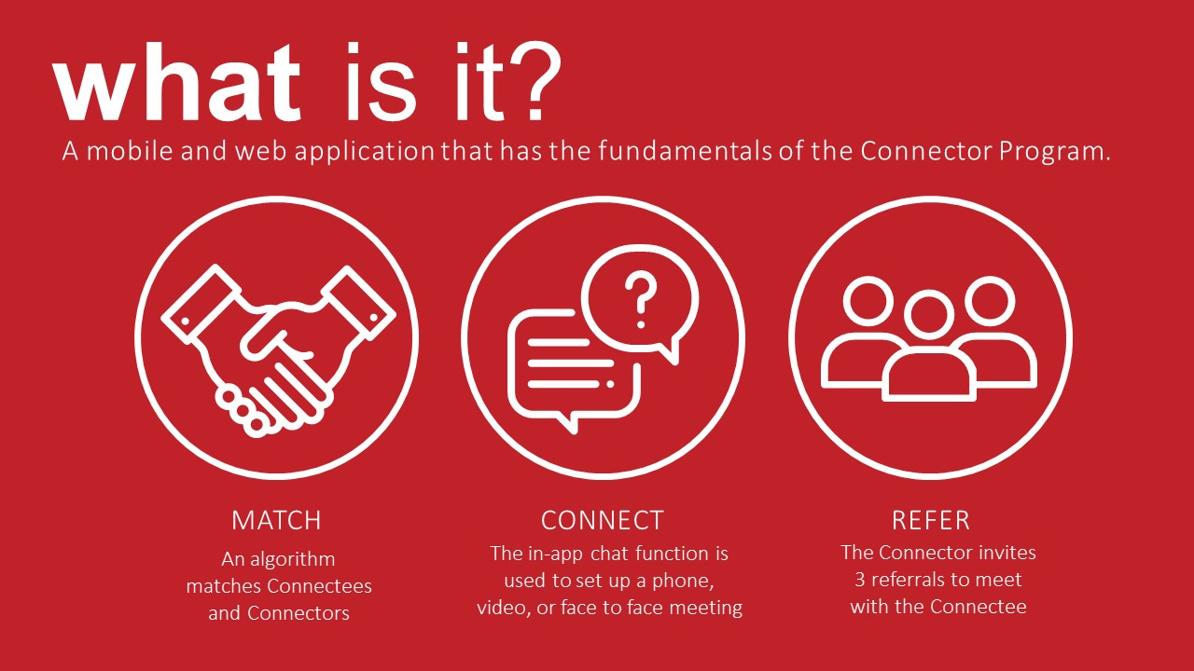
what is it?
A mobile and web application that has the fundamentals of the Connector Program.
match
connect
refer
An algorithm matches Connectees and Connectors
The in-app chat function is used to set up a phone, video, or face to face meeting
The Connector invites 3 referrals to meet with the Connectee
Notes:
In 2009, the Halifax Partnership launched the Connector Program, which is a simple, yet highly effective networking program that helps local organizations connect with immigrants and recent local and international graduates who are interested in growing their careers.
How it works, is a Connectee - or job seeker, is matched with a community leader (Connector), and they connect over coffee – either at the Connector's office or a coffeeshop nearby. After the meeting, the Connector then refers, or introduces the student to three others in their network, and the process repeats.
Through direct referrals, Connectees learn about the local job market and rapidly grow their business network which increases their likelihood of finding a job and staying in Halifax.
Connectors benefit by gaining access to pre-qualified job seekers and helping to grow their industry and the local workforce.
Although the app is a little different, I wanted to explain the basics of the program first.

Slide 16
who is it for?
what is it?
International and local grads who want to build their career in the province they grew up in or earned their post-secondary education in.
Intra-provincial connections are now possible via the app.
Notes:
To give a bit of an intro to the Connector Program, many times we hear “It’s not JUST about what you know” or “It’s not JUST about who you know”. The reality is, it’s actually about both.
As a recent grad, you need the skills and qualifications AND the professional network to open the doors to gain successful employment in their field.

Slide 17
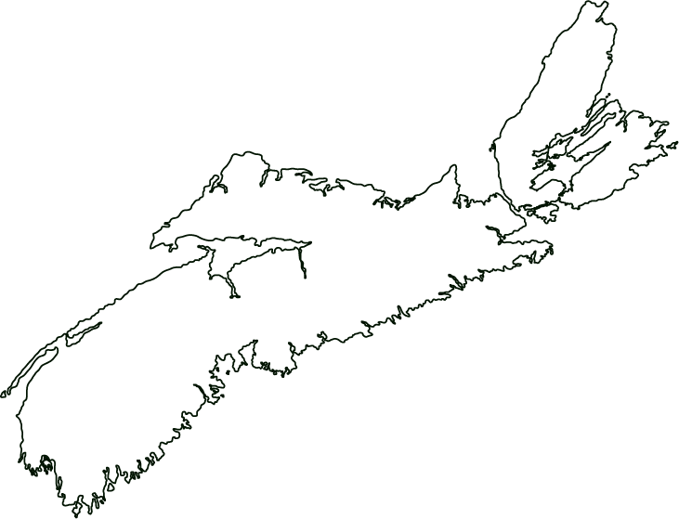

where & when is it available?
2018-2019:
International and local graduates who studied in Nova Scotia connect with community leaders across the Province
Connectees access a resource
hub with local labour market
information and interview and networking tips
2019-2020:
Accessible by the
2022-2023:
32,000+
If proved effective, roll out to National Connector Communities across Canada
graduates across Atlantic Canada
Notes:
This brings us to the Connector App.
With an app, more Connectees can participate in the Program and Connectors can choose exactly how often they want to meet with Connectees. The App would be province wide – so a student that studied at any of the post-secondary institutions in the province would select where in the province they want to be matched. They can also access a resource hub, and expectations will be clear through a guided tutorial upon sign-up.
The plan is to launch it across Nova Scotia in year 1, across Atlantic Canada in year 2, and our goal is that by 2022, 15% of Atlantic Canadian graduates are active users. We understand this is an aggressive goal and we are working with 2 great partners to help achieve this.

Slide 18
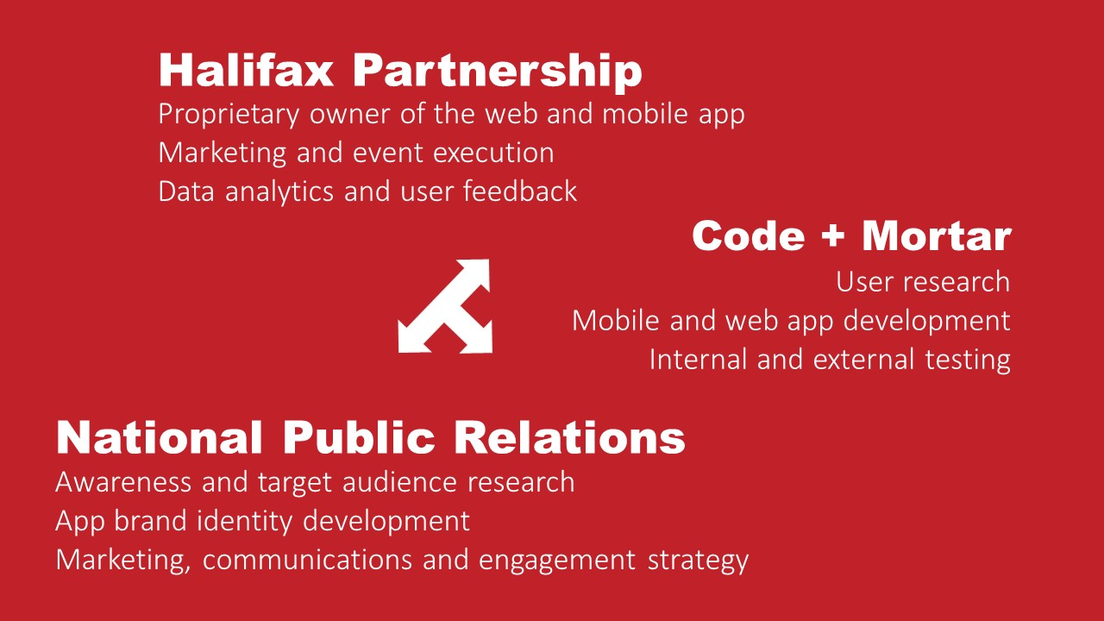
Halifax Partnership
Proprietary owner of the web and mobile app
Marketing and event execution
Data analytics and user feedback
Code + Mortar
User research
Mobile and web app development
Internal and external testing
National Public Relations
Awareness and target audience research
App brand identity development
Marketing, communications and engagement strategy

Slide 19
Breakout sessions

Slide 21

Networking Resources for Connectees

Slide 23

Game Changers Gala
Cocktail hour 5pm
Dinner 6pm

Slide 24


Slide 25

Best Practices for Sponsorship
Notes:
Hi everyone, I’m Clara, Manager, Communications at the Halifax Partnership
About me
Today best practices in sponsorship agenda:
why sponsorship
the process in 8 steps
tops tips for success
resources
questions

Slide 26
Why seek sponsorship?
Industry collaboration
Capacity building
Third party endorsement
Potential for Connector Organization

Slide 27
The sponsorship process in 8 steps
Asset Building
Prospecting
Discovery
The Pitch
The Close
Activation
Fulfilment
Renewal
Notes:
So today we’re going to go over the basics of the sponsorship process. It’s important to think about sponsorship as a process because every step helps facilitate the next step and sets you up for success.
Asset Building
Prospecting
Discovery
The Pitch
The Close
Activation
Fulfilment
Renewal

Slide 28
The sponsorship process Step 1: Asset building
Asset Building
Create inventory of assets: what can you “sell”?
  What can you combine and package in new ways that allow your prospects to get in front of your audience?
Can sponsors access these assets without us?
  What is your unique offering/value proposition?
Notes:
a. Create an inventory of assets that you can sell (identifying what you can sell)
i. What can you combine and package in new ways that allow your prospects to get in front of your audience?
ii. (Marketing/Comms logo placement, thought leadership, digital assets, naming rights, blogs, events, etc.)
b. Can sponsors access these assets without us?
i. What is your unique offering/value proposition?
Connector Program: talent

Slide 29

The sponsorship process Step 2: Prospecting
2. Prospecting
researching and identifying potential sponsors
  current network
  large/growing local employers
  companies with CSR goals/campaigns
Notes:
Researching and identifying potential private sector sponsors
Consider:
a. Current network
b. Large employers
c. Growing employers
d. Connector organizations
e. Companies that have goals which align with program value

Slide 30

The sponsorship process Step 3: Discovery
3. Discovery
conversation with prospect
  asking questions
  learning more about their goals, needs, process
Notes:
a. First meeting should be a conversation – to learn more about their needs and goals
What are their business goals? CSR goals? Who are they looking to reach? Are they growing/hiring?
b. Two way – not one way presentation: determine if there is an opportunity to work together
d. Ask questions: process, timelines, decision makers
e. Face to face conversation about the company and their goals. Determine their goals, audience, how they like to partner. Ask questions

Slide 31

The sponsorship process Step 4: the proposal
4. The Proposal
What is the problem you are able to solve for the prospect?
What is the value of the problem you are solving?
Notes:
What is the problem you are able to solve for the prospect?
What is the value of the problem you are solving?

Slide 32
The sponsorship process Step 4: the proposal
4. The Proposal
align with goals of company
determine value
examples of benefits
  Brand profile: Speaking opportunities, thought leadership
  Access to talent: becoming Connector Organizations
Notes:
a. Align to goals of company
i. Going beyond logo placement – direct ROI (recruitment)
Determine value
Examples of benefits:
-Brand profile: speaking opportunities, thought leadership, logo placement
-Access to talent: support in becoming Connector Organization, access to qualified talent, speed interviews

Slide 33
The sponsorship process Step 4: the proposal
4. The Proposal
Elements of a sponsorship proposal
  common goal/purpose or problem
  opportunity
  benefits
  organization and contact information
Formats
Notes:
a. Elements of a sponsorship proposal/package
i. Purpose/common goal/problem
ii. Opportunity to work together
iii. Benefits/activations (different types, dates)
iv. About your organization/contact information
1. Quantify as much as possible (marketing, events)
2. Be specific (dates)
b. Different formats for different companies (ensure you ask and understand their processes. Online or physical copy? Portal or email? Is there a form to fill out?)

Slide 34

The sponsorship process Step 5: the contract
5. The Contract
Notes:
Take a moment at this stage to celebrate. Congratulations! You made it to the contract stage.

Slide 35

The sponsorship process Step 5: the contract
5. The Contract
Elements of the contract
  company information and contacts
  sponsorship description
    total amount
    time period
    benefits
    additional terms of agreement
  signature line
Notes:
a. Company, address, website,
b. Primary contact information (any secondary contacts, admin, senior, marketing, etc)
c. Sponsorship description
i. Total amount
ii. Period
iii. Benefits
iv. Any additional terms of agreement
v. Signature line (for both client and organization)
vi. Please return to contact

Slide 36

The sponsorship process Step 6: activation
6. Activation
Executing on the plans
Ongoing mindfulness for opportunities
Keep track of benefits and value offered
Notes:
6. Activation
Executing on the plans
Ongoing mindfulness for opportunities
Keep track of benefits and value offered

Slide 37

The sponsorship process Step 7: fulfilment
7. Fulfilment
Measure success
  what was promised vs. what was delivered
In advance of renewal, share success
Notes:
7. Fulfilment
Measuring success
Show what was promised vs what was delivered
Months before the renewal date, compile report on success

Slide 38
The sponsorship process Step 7: fulfilment
7. Fulfilment
Report card
  marketing metrics
    blogs, social, newsletters, etc.
  speaking opportunities/event numbers
  If possible: Connectees referred or jobs found
Notes:
7. Fulfilment
Measuring success
Show what was promised vs what was delivered
Months before the renewal date, compile report on success

Slide 39
The sponsorship process Step 8: renewal
8. Renewal
Fulfilment report → Renewal
Notes:
A proper fulfilment report leads to a renewal

Slide 40
Tips for sponsorship success
Focus on strategic alignment
Be specific
Maintain relationships at different levels
Check-in regularly
Continuously look out for additional/creative opportunities
Notes:
Focus on strategic alignment between organizations
Be specific
Maintain relationships at different levels of the organization
o Primary contact
o decision makers
o marketing/communications or community relations
o recruitment/HR
Check-in regularly
Always look out for additional opportunities/be creative

Slide 41
Sponsorship Resources
TheSponsorshipCollective.com
PowerSponsorship.com
PracticalSponsorshipIdeas.com
Notes:
TheSponsorshipCollective.com
PowerSponsorship.com
PracticalSponsorshipIdeas.com

Slide 42
Thank you
Questions?

Slide 43
Recruiting Connector Organizations

Slide 45
Finding Content for Social Media

Slide 46
Super Connector Campaign

Slide 47


Slide 48
Regional Collaboration

Slide 49

Parking Lot

Slide 50

Fin

