Slide 1
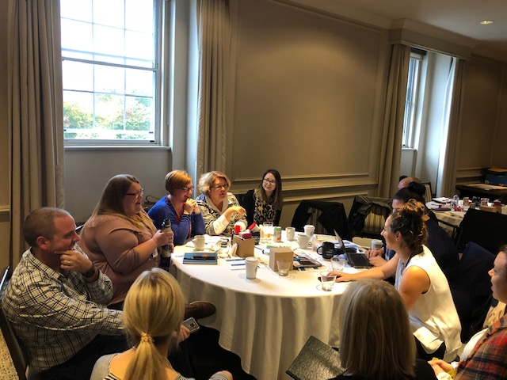

Learning Exchange 2019
Westin Nova Scotian, Halifax, Nova Scotia

Slide 2


#HireMeHalifax
PITCH COMPETITION & NETWORKING EVENT

Slide 3
Game Changers Youth Retention Action Plan
Youth retention initiative that ran 2015 to 2018
Aimed to stem youth outmigration in Halifax
Inspired and supported businesses to hire youth, offer experiential learning opportunities, and become a Connector
Notes:
In 2015, the Halifax Partnership launched the Game Changers Youth Retention Action Plan to increase youth retention in Halifax. Its primary purpose was to change the attitudes and behaviours of businesses to provide entry-level positions for youth aged 20-29, to help them build their business network, and to demonstrate to youth that they could find entry-level positions aligned with their education and experience, and build their lives here, in Halifax.

Slide 4
The Goal
Connect businesses to job seekers
Showcase young and emerging talent
Change attitudes around hiring youth
Notes:
These were the goals of Game Changers, and #HireMeHalifax is one way we worked toward these goals

Slide 5
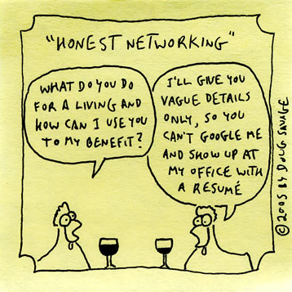
#HireMeHalifax
Pitch competition
Networking event
Social media campaign
Notes:
Launched with Game Changers by our Connector team as Pitch It! It was conceived when Partnership staff were thinking about how to engage youth, who were already spending time on their phones and on social media, and that’s where the video pitch idea came from
Networking is hard, nerve wrecking for some people. So we tried to make it more approachable.
2016 renamed as #HireMeHalifax and incorporated into our Game Changers Youth Retention initiative
After Game Changers ended, in 2019 by Connector team and EL
Two elements: Pitch Competition and Networking Event
Youth ages 20-29 looking for employment in Halifax enter a 30-second video telling employers why they should hire them
The top 10 pitches are performed and judged live at a networking event
Any job seekers and business professional in Halifax is welcome to attend the event
Marquee event with 200+ attendees of business professionals, students and grads, Connectees, and post-secondary institutions
Also a social media campaign, first to promote the contest and event, then we encourage employers and job seekers to use the hashtag to find each other

Slide 6
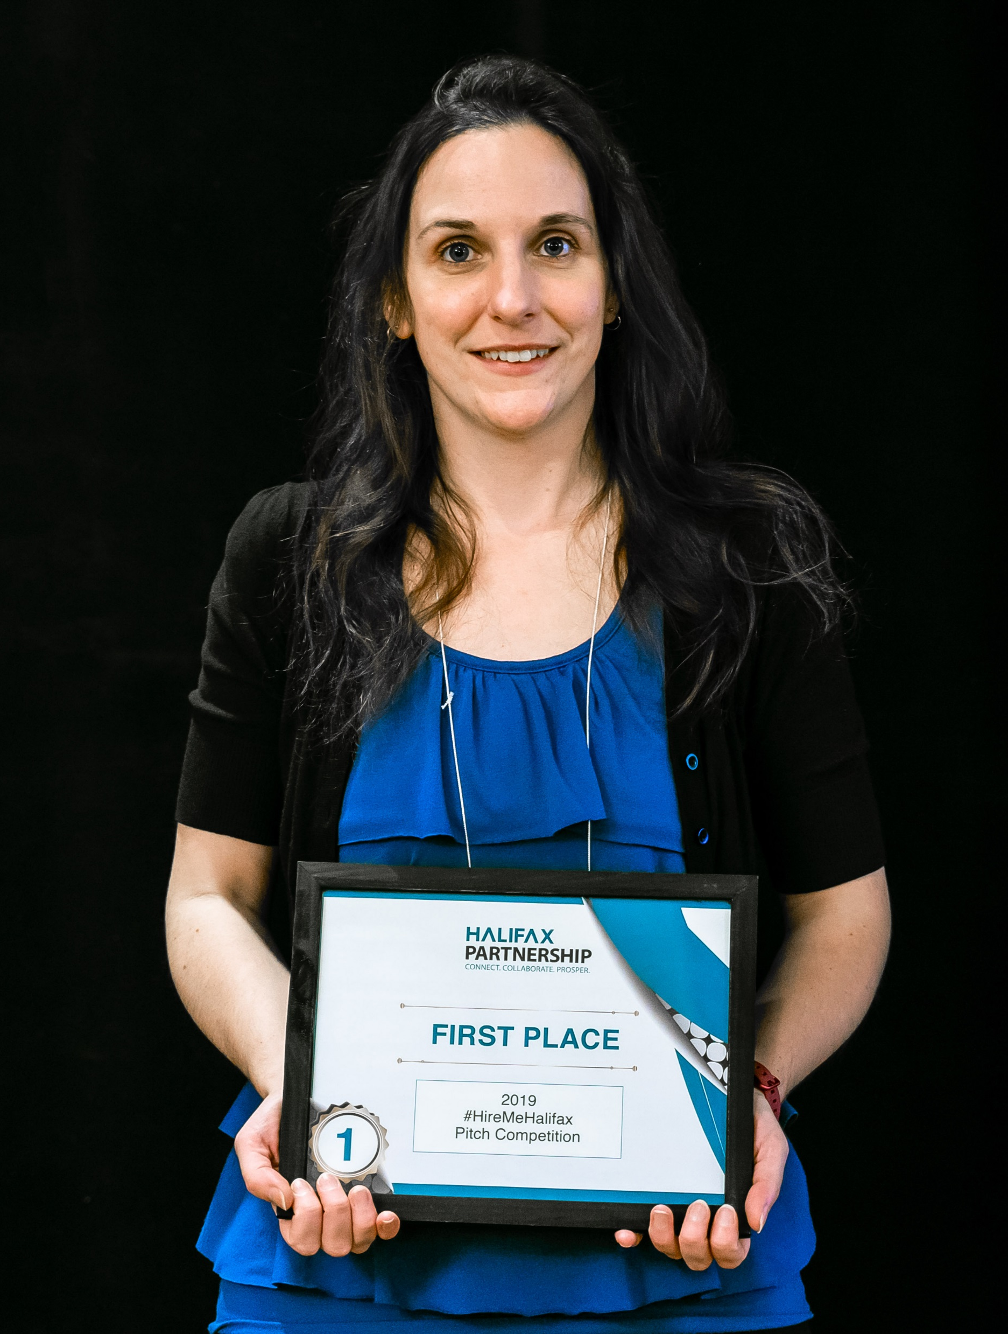
Benefits for Connectees
  Unique opportunity to network with employers even if they don’t pitch)
  Gets job seekers thinking about their pitch
  Cash prizes
Notes:
The only event of its kind in Halifax
Benefits students, grads, and immigrants by getting them to think about how they would pitch themselves to an employer, thinking about the idea of developing a pitch, and actually putting it into practice
Cash prizes: $1,000 for first, $300 for second, $200 for third
Chad’s story

Slide 7
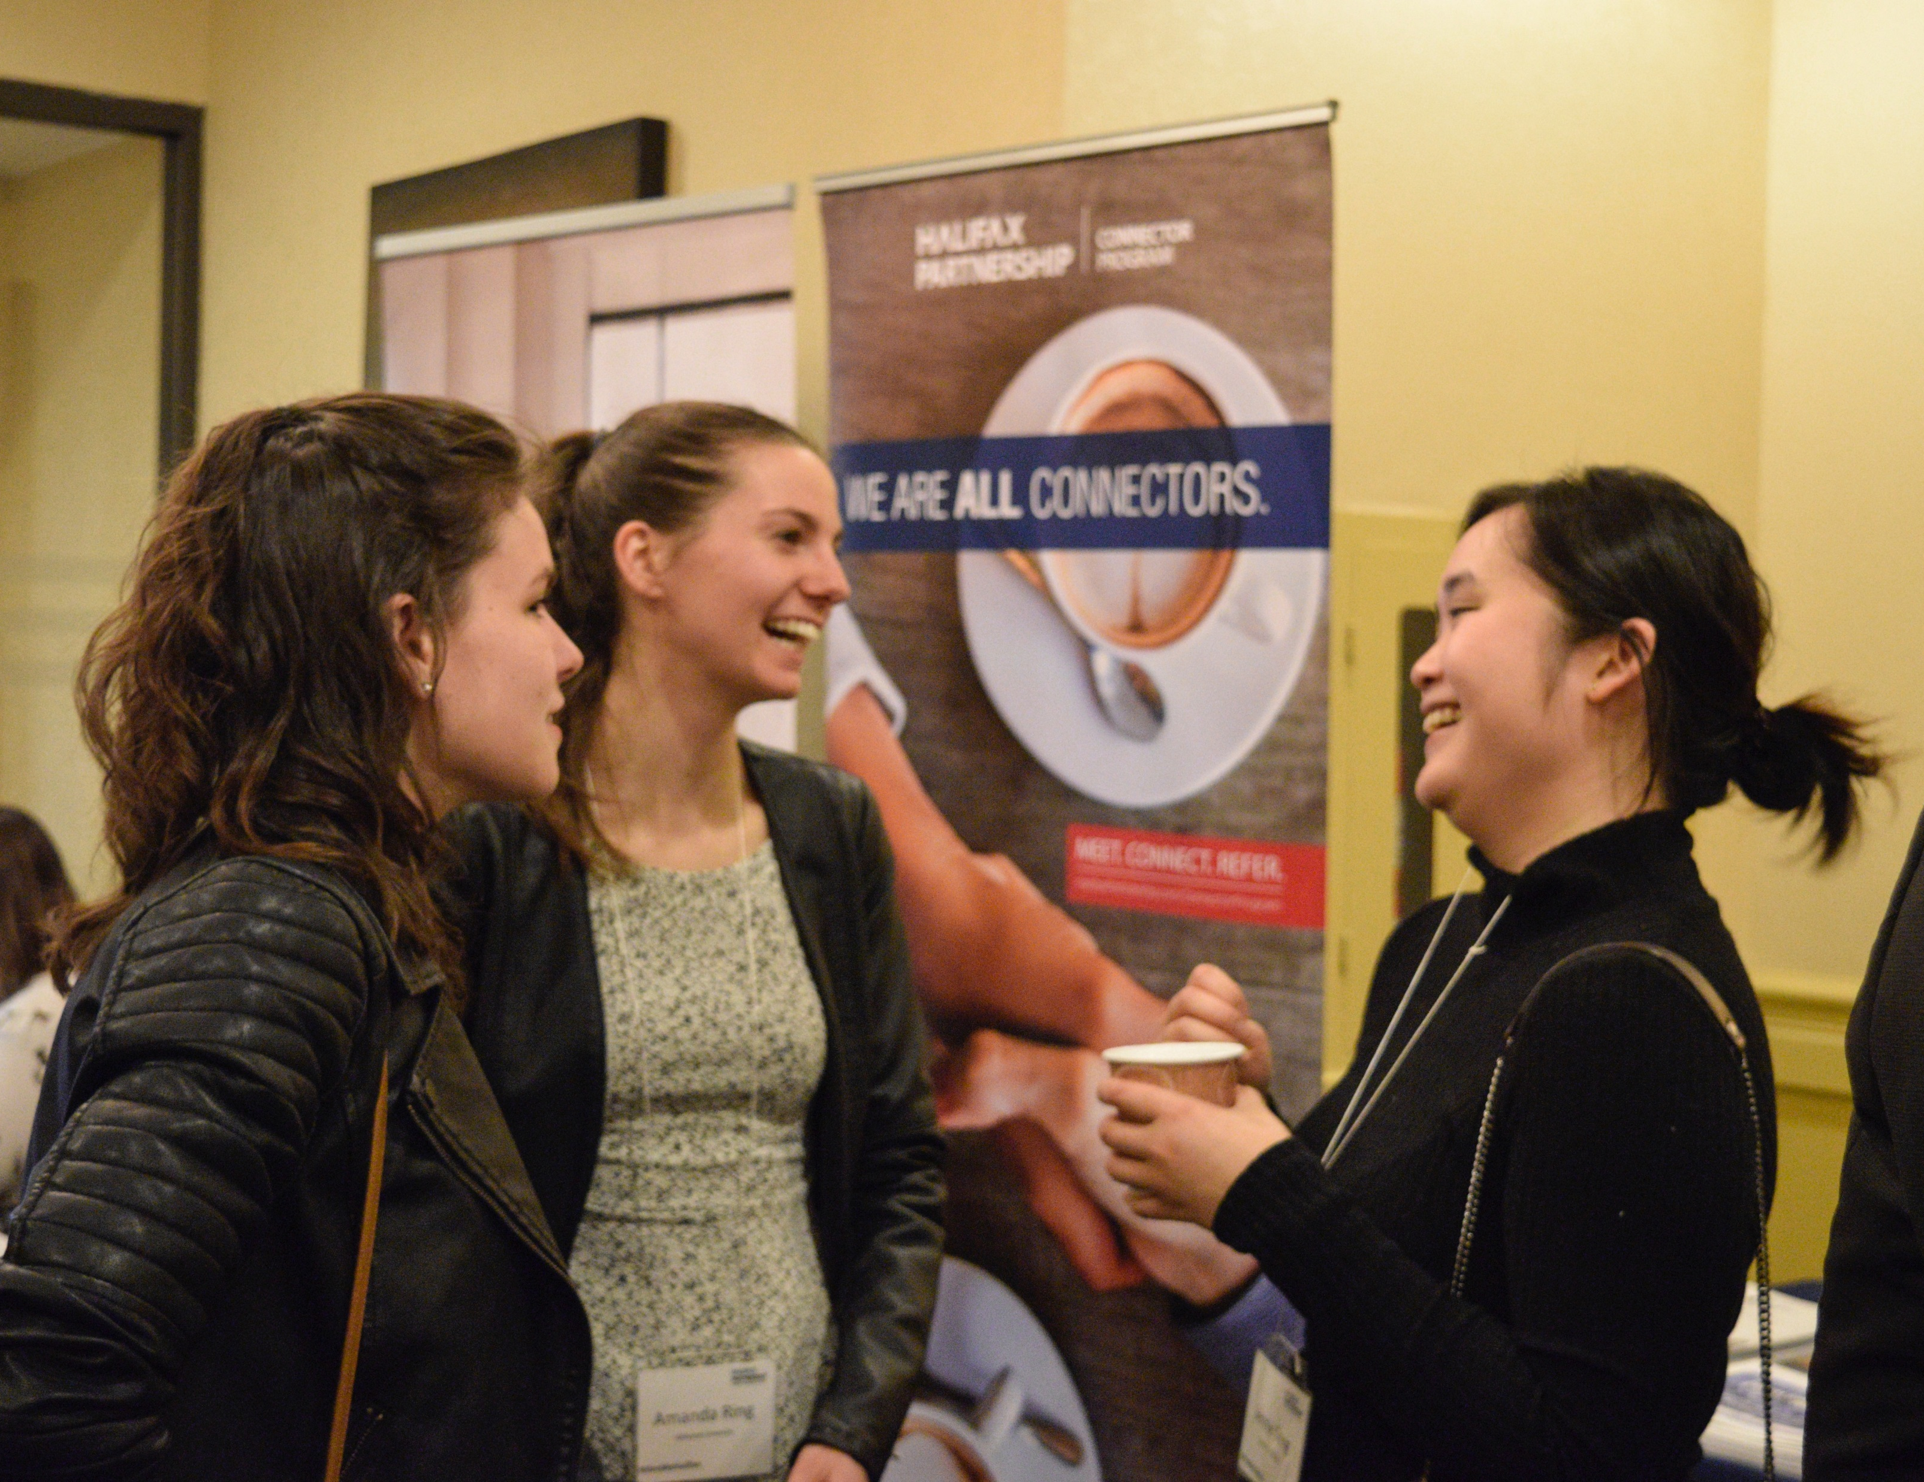
Benefits for Connectors
Meet skilled talent
Network face-to-face with job seekers
Offer interviews or hire on the spot (it has happened!)
Notes:
Story about someone who hired (TD hired two finalists in 2018)
Connectors were raising their hands to pitch their own businesses and job openings to the job seekers in the room

Slide 8

HOW WE
DO IT

Slide 9
Pitch Competition
Contest period open for one month
Promote via social media, posters, classroom presentations, and direct email
Submissions accepted through Woobox.com
Notes:
Contest period open for one month. We tried a week in year 1 and received less submissions. We open the contest early February to early March because of close to graduation but not interfering with exams, and overlaps with reading week. But note that many submissions will come in the day before or even day of the deadline
Promote via social media, posters, post-secondary classroom presentations, direct emails to Connectees
Contestants upload a Youtube video and submit the link through Woobox, a contest platform (to avoid viruses or emailing of large files) which has the option for free and paid accounts
Story: when searching #HireMeHalifax on Youtube for this presentation, I found two videos from last year that were not submitted through Woobox and therefore were not entered… so following instructions is important!

Slide 10

Marketing and Promotion
Notes:
Promotion is critical to having a good number of submissions and successful event attendance
There are two components to marketing and promotion: the contest and the event
For marketing the contest, we’ve found social media advertising, in person presentations at post-secondary schools, and posters are most effective. Here’s a sample ad

Slide 11

Marketing and Promotion
Notes:
For marketing the event, e-invitations, digital marketing, and direct marketing with word of mouth and phone calls to businesses we thought would be interested in attending were effective

Slide 12

PROMO VIDEO
#HireMeHalifax 2017
Notes:
https://www.youtube.com/watch?v=2t0uld3NaUo

Slide 13
Judging
Round 1: Partnership staff judge all submissions and identify top 20
Round 2: Partners and business community reps select top 10
Round 3:Top 10 pitch live at the event to a panel of judges
Notes:
Three rounds (using rubric and criteria)
Staff (Marcomm and Labour Market) judge all submissions and identify top 20
Partners/representatives from the business community judge top 20 and identify top 10
Top 10 pitch live at the event
Four judges: One from the Connector team, three prominent Connectors/youth hiring business reps
To ensure finalists are diverse in culture and field of study, the judges much also reflect diversity, or be aware of their unconscious bias. One year our top 10 was lacking in diversity. How we addressed this was by opening the live pitch up to the top 15, engaging more diverse judges the following year, and have a brief discussion about unconscious bias

Slide 14
Judging Criteria
Pitches should include:
Your name, degree, and field of work
Whether you’re in search of a full-time or experiential learning opportunity
Career ambitions
The type of company you want to work with
What makes you stand out (relevant experience, soft and hard skills)
Pitch Criteria:
No more than 30 seconds long
Highlights your skills and what you can offer a business
Professional language and presentation
Business attire

Slide 15
Networking Event
2:30 pm: Dress rehearsal for pitch finalists
3:30 pm: Networking workshop
4:00 pm: Registration and networking
4:30 pm: Pitch competition
5:00 pm: Break for judges to convene
5:15 pm: Winner announcement
5:20 pm: Networking resumes
6:00 pm: Event closes
Notes:
Typical agenda
Invite Connectors and members of the business community (e-invites and personal invites)
Promote as an opportunity to hear pitches and network with students and soon-to-be and recent graduates
We do a 4-6 event with passed appetizers
We’ve tried various fees in the past for business: free for investors, startups and non-profits and $30 for everyone else most recently. Have also done $30 for investors, startups and non-profits and $50 for everyone else. Always free for job seekers

Slide 16
Post Event
Winners ad
Finalists’ videos on Youtube channel
Press release
Letters of congratulations to post-secondary Presidents
Notes:
Winner ads (winner bios and headshots) using in-kind investment. Pass around last year’s.
Finalists’ videos on our Youtube channel and promote on social (key to this: in the Woobox submission form, we include a question asking permission to share the video)
Press release announcing winners. We also invite media to the event. In 2017 our winner was interviewed on site at the event.
Letters of congratulations from our CEO to Presidents of winners’ schools

Slide 17

Tips for Replicating
Partner with post-secondary institutions and the business community
Set a long contest period
Promote, promote, promote!
Open invitation to event
Judges from diverse backgrounds and fields
Notes:
We open it up to the entire business and PSE community, not just Connectors and Connectees. At the event we invite everyone in attendance to sign up for the program.
Strong partnership with post-secondary schools. We always get the most submission from Nova Scotia Community College, where we do in-person presentations and one class has the pitch as part of their cirriculum
Our network of 100+ private and public sector investors is one of the success factors. They are keen to attend the event, help with promotion, and even participate as judges. If your organization doesn’t have this type of network, connect with your local BIDs and Chambers of Commerce.
Set a long contest period
Promote a lot (most submissions will come in during the final days)
Posters at schools are effective (story: posters in science building)
Social and digital media advertising
Ensure judges are privy to diversity in culture and field of study
Feedback on why only for under 30. If you get questions about why you’re limiting the contest to a certain group (could be youth, immigrants, grads, etc.), connect is back strongly to a larger strategy
After Game Changers we changed criteria to recent grad within two years (any program, undergrad, grad, PhD)

Slide 18
Other Ideas
Videos
Networking tips in promotion
Networking prompts on name tags
Booths during networking time
Private sector sponsors
Open competition to current students
People’s Choice Award (Survey Monkey)
Notes:
Some other ideas/things we’ve tried
Promo video
Pitch compilation video
Quick networking tip videos filmed in our boardroom leading up to contest deadline and/or event
Networking prompts on name tags
Booths/trade show during networking time for PSEs and key partners
Private sector sponsors judge and give remarks
Opened contest to students looking for EL
Added People’s Choice winner
We’re doing it again, next one is in March

Slide 19

COMPILATION VIDEO
#HireMeHalifax 2017
Notes:
https://www.youtube.com/watch?v=BRDj15TgDVo

Slide 20

The Guide to Hiring Youth
Notes:
Distribute copies

Slide 21
The Guide to Hiring Youth
  60-page guide for employers
    Hiring resources and information
    Success stories
    Ads and articles
  PDF posted on our website
  Printed and distributed physical copies
    Distributed via mail and at events
Notes:
What it is
60 page guide with hiring resources, incentive information, success stories, program information, ads, articles such as “why hire youth” dispelling myths. Ads and articles from private and post-secondary partners
Released in 2017
What we did
Created a physical document and digital document
Worked with a professional designer
Distributed copies via mail and at events

Slide 22
Employer Feedback
  Hiring incentives and program information were useful
  Wanted easy access to this info
Notes:
We’re always evaluating and collecting feedback on our tactics. Earlier this year we held engagement sessions with youth, business, and post-secondary partners to gather input and ideas for relaunching Game Changers. The Hiring Guide is one tactic we asked for input on in the business session
They wouldn’t peruse it casually, they want easy access to the useful info (incentives, resources)

Slide 23
What We’re Doing Differently
  Digital version
    No physical document or distribution
  Paired down
    Resources and incentives only
    More information on each
  Reminders and e-blasts before deadlines
Notes:
Digital version (more interactive instead of just a PDF, no print version)
Paired down
Resources and incentives only
Also wanted even more info on each
Also asked for reminders in the form of e-blasts before funding deadlines, which is when they’re most likely to take advantages of the incentives

Slide 24
QUESTIONS?
Notes:
They might ask about $ and sponsors, how much can I share?
Does HP own the idea/do we give HP credit?
How many people were hired?

