Slide 1




Networking 101
Connector Bootcamp
PRESENTED BY
Nathan Laird, Nada Halaweh, AJ Simmonds & Luz Lima-Upham
Presented by:
Nathan Laird, Program Manager, Halifax Connector Program

Slide 2
YOUR AGENDA
9:00 - Welcome/Outline Day
9:10 – 10:00 – Discussion with RBC
10:00-10:30 – Local Labour Market Discussion
10:30-10:45 - Break
10:45-12:00 - Job Search Strategies (Job Boards, Recruiters, Target Lists)
12:00 – 1:00 – Lunch
1:00 – 2:00 – Networking (in-person/LinkedIn)
2:00-3:00 – Resume Review, Interview Strategies and Q&A
3:00-4:00 – Discussion with Kurt Benson, VP Magnified Public Relations

Slide 3
HALIFAX PARTNERSHIP OVERVIEW
  The Halifax Partnership is Halifax’s economic development organization. We help keep, grow and get business, talent and investment in Halifax. We do this through leadership on economic issues, our core programs, our partnerships across all sectors, and by marketing Halifax to the world.
  We are connectors. We know Halifax and can make the connections that fuel business and economic growth. Through our partnerships and acclaimed programs, like SmartBusiness and Connector, the Partnership creates opportunities for people to connect and collaborate on big and small ideas that make our great city grow and prosper.

Slide 4
CONNECTOR PROGRAM EXPECTATIONS
  The Connector Program team will meet with each participant to discuss their background, review their resume and provide relevant labour market information.
  The team will endeavor to provide a relevant industry connection who will meet and provide additional referrals.
  The Connector Program is not a job search program or a mentorship program…there is no expectation of receiving interviews or job offers.
  The Connector Program assists with making the first connection, however it is up to participants to make positive impressions and continue the networking process.

Slide 5
Networking 101
Please Welcome RBC
Presenting sponsor of the Halifax Connector Program
Presented by:
Nathan Laird, Program Manager, Halifax Connector Program

Slide 6
Networking 101
Labour Market Overview
PRESENTED BY
Nathan Laird
Presented by:
Nathan Laird, Program Manager, Halifax Connector Program

Slide 7
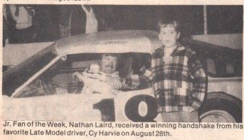
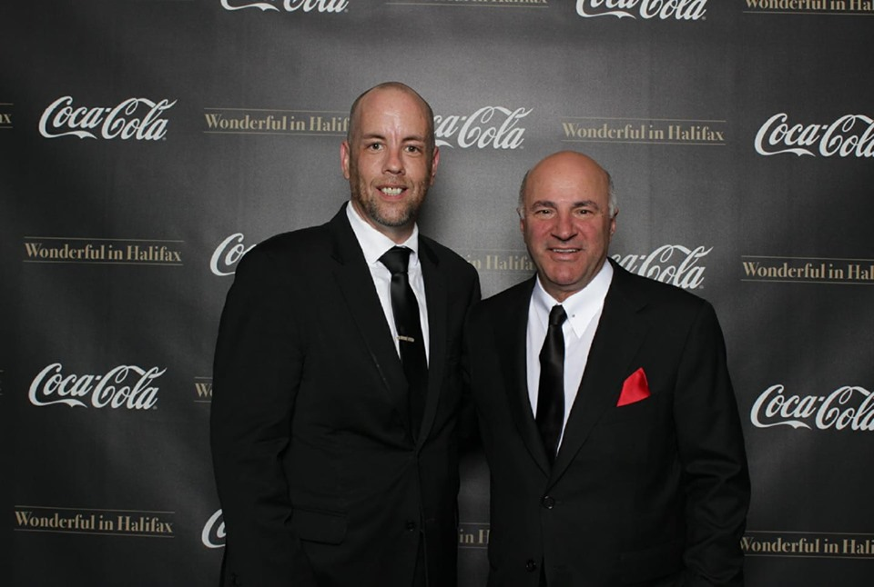
WHO IS NATHAN…
  Nathan Laird – Program Manager
    Bachelor of Arts in International Relations - 1999
    Master of Arts in 20th Century Military History – 2001
    Minimum Wage Jobs in Truro – 2001-2004
    Customer Service Agent @ Convergys – 2004
    Trainer @ Convergys – 2005
    Sales Manager/Operations Manager @ Convergys– 2006-2009
    ---------------------------------------------------------------------------------------------------
    Inside Sales & Account Management @ Xerox – 2010-2012
    Business Development & Consulting @ ADP – 2012-2015
    ---------------------------------------------------------------------------------------------------
    Business Development Manager @ Kelly Services – 2015-2016
    Branch Manager @ Adecco – 2017
    Happiest Program Manager Alive @ Halifax Partnership - 2017-present

Slide 8
HALIFAX LABOUR MARKET
Growth Industries:
  IT (REDspace/Athletigen/) & ICT (Volta/SimplyCast/CGI), Financial Services, Skilled Trades (Manufacturing/Air Conditioning Repair), Engineering, Ocean Tech (GIT/Ashored), Business Development.
Major Employers:
  RBC, IBM, NTT Data, Manulife, CGI, Emera, Staples, Irving Shipbuilding, JD Irving, Post-Secondary Institutions, City of Halifax and Province of NS.
Banks:
  RBC – personal banking, commercial banking, IT, back office
  Scotiabank – personal banking, commercial banking, virtual banking advisors, contact center client service
  TD – personal banking, commercial banking, TD insurance contact center
  CIBC - personal banking, commercial banking, contact center client service
  BMO - personal banking, commercial banking,
Notes:
Growth Industries:
ICT: Interactive media, IT services, Transatlantic telecommunications, Enterprise solutions, E-health applications, Data analytics
Ocean Tech start-ups
Example 1 : GIT (Graphite Innovation and Technologies)-cofounders (SMU graduates) found a more affordable way to produce graphine that prot4ects ship hulls from corrosion
Example 2: Ashored Innovations: founded by 3 SMU grads, developed a smart lobster trapping system

Slide 9
HALIFAX LABOUR MARKET
Occupational Data for 2018 | Employment | Employment Share | Avg. Hourly Wage | Job Vacancies | Vacancy Rate
All Occupations | 234,200 | 100.0% | $18.23 | 6,153 | 2.6%
Natural and applied sciences and related occupations | 19,200 | 8.2% | $29.21 | 495 | 2.6%
Professional occupations in natural and applied sciences | 10,900 | 4.7% | $32.25 | 279 | 2.6%
Technical occupations related to natural and applied sciences | 8,400 | 3.6% | $24.61 | 180 | 2.1%
Trades, transport and equipment operators and related occupations | 30,000 | 12.8% | $18.14 | 813 | 2.7%
Industrial, electrical and construction trades | 11,700 | 5.0% | $20.85 | 143 | 1.2%
Maintenance and equipment operation trades | 5,400 | 2.3% | $22.67 | 135 | 2.5%
Business, finance and administration occupations | 40,400 | 17.3% | $19.24 | 693 | 1.7%
Professional occupations in business and finance | 10,900 | 4.7% | $23.26 | 200 | 1.8%
Administrative and financial supervisors and administrative occupations | 13,300 | 5.7% | $20.08 | 177 | 1.3%
Finance, insurance and related business administrative occupations | 2,800 | 1.2% | $19.95 | 15 | 0.5%
What’s on the table?
Relevant Occupation Category
How many people are employed in that occupation in Halifax
What share that employment makes up of total employment
Typical hourly wage
Number of vacancies estimated for that occupation
Vacancy rate (vacancies/employment)
Overall Trend:
High demand for Finance, Skilled Trades & Engineering (among other natural & applied sciences)
Source: Stats Canada, Labour Force Survey
Notes:
Note: the NOC-code system (The National Occupational Classification-4 digits) does not cover the IT/ICT fields well, as they tend to get subdivided into many other industry groups.
Category 1:
Professional occupations in natural & applied sciences:
-All disciplines of engineering
-Architects, urban planners
-Mathematicians, statisticians
-Life science professionals: biologists & related scientists
Technical occupations in related to natural & applied sciences:
-Chemical and biological technologists
-Civil engineering & mechanical engineering technologists
-Architectural technologists
Category 2: Trades, Transport & Equipment Operators:
-Contractors, supervisors, electrical trades, carpentry, repairers, etc.
-Electricians, telecommunications line & cable workers

Slide 10
Networking 101
Job Search Strategies
PRESENTED BY
Nathan Laird
Presented by:
Nathan Laird, Program Manager, Halifax Connector Program

Slide 11
JOB SEARCH STRATEGIES – JOB BOARDS
General Job Boards:
  www.careerbeacon.com
  www.indeed.ca
  LinkedIn Jobs
  www.jobbank.gc.ca
Industry Specific Job Boards:
  Digital Nova Scotia (https://opportunities.digitalnovascotia.com/find-a-job/)
  CPA Atlantic (Accounting) (https://www.cpans.ca/web/CPANS/CareersVolunteer/Employment_Opportunities.aspx)
  Engineers Nova Scotia (https://engineersnovascotia.ca/careers/)
  CPHR-NS (HR) (https://cphrns.ca/)
  ACADA (Aerospace & Defence) (https://ac-ada.ca/jobs)

Slide 12
DEVELOP A TARGET LIST
Don’t always rely on the major job boards, a lot of companies don’t advertise their open positions there.
-Hidden Job Market: the jobs that aren’t posted online
If possible, look for a related industry association (i.e. Digital Nova Scotia, Engineers Nova Scotia) and build a target list from their member companies.
Once you have a target list, check their individual job boards often. If possible set up email alerts.
Use LinkedIn to connect with relevant people from your target list

Slide 13
RECRUITERS
Recruiting firms primarily fill two types of roles:
Temporary/Contract – These positions are for a set period of time, typically between 1 week-2 years and are working at a client location. With these positions, employees are paid by the staffing company and their client pays a premium for each hour worked.
Permanent – These positions are where a recruiter has been engaged to run a search to find a candidate with specific skills. With these positions, the company is paying the recruiter a fee to identify candidates, but the company makes the final hiring decision.

Slide 14
RECRUITING FIRMS IN HALIFAX
General Recruiting/Staffing:
Adecco, Kelly Services, Manpower, Supertemp, Talentcor, Maxsys, Integrated Staffing, Strictly Staffing, Talentworks, Drake
Professional/Technical Recruiting:
David Aplin Group, Venor, Meridia, Randstad, Summit Search Group, Locke Search Consultants, Nicom IT Staffing
Executive Recruiting:
Knightsbridge Robertson Surrette, Gerald Walsh & Associates, Snow Recruit, Royer Thompson

Slide 15
RECRUITING FIRM TIPS
All fees paid to recruiters should be paid by the company engaging their services. No reputable recruiter will ask for a fee from a job seeker.
Remember, recruiters work for the company who retains them, not the job seeker. Their goal is not to be an employment coach or to find you a job, their goal is finding the best candidate to fill the role for their clients.
Register with a number of different firms, they often work with different clients. Many firms have specializations, so investigate which are most relevant to your skills.
Follow up with them periodically to stay top of mind.
If a recruiter engages you for a job opportunity, make their life easy…be responsive, be patient, be on-time, accommodate their interview requests when possible

Slide 16
Networking 101
Networking 101
PRESENTED BY
Nada Halaweh, AJ Simmonds & Luz Lima-Upham
Presented by:
Nathan Laird, Program Manager, Halifax Connector Program

Slide 17
NETWORKING BY THE NUMBERS
64%
Said in-person networking helped them find a new job
or advance their career
88%
Said networking directly or indirectly helped
their careers
69%
Said they found increased job opportunities
as a result of networking

Slide 18

WHY IS NETWORKING IMPORTANT?
  DISCOVER opportunities
  UNCOVER the hidden job market
  GROW your professional network
Notes:
Discover opportunities
Upcoming short-term projects, volunteer opportunities, conferences, etc.
Tap into the hidden job market
A significant number of jobs are never posted, but rather filled through people leveraging their personal networks
Grow your professional network
Recruiters typically spend about 10 seconds browsing your resume, and having a connection at a given company can help move your resume to the “interview” stack

Slide 19


DIGITAL NETWORKING
  Job seekers can identify target organizations or individuals and contact them
  Employers can headhunt specific skills/backgrounds
  Having a strong LinkedIn profile can be a differentiator in a job interview
  What do you think makes a great LinkedIn profile?
Notes:
Recap
LinkedIn has revolutionized networking and recruiting.

Slide 20
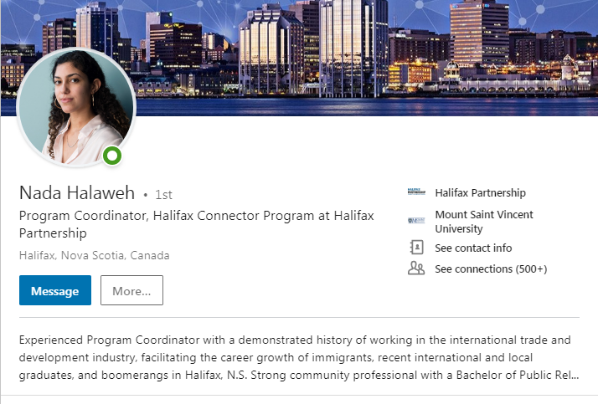
LINKEDIN TIPS
Professional headshot
Complete and up-to-date information
Carefully chosen groups
Well written summary
Professional experience and education
Languages, certifications, and publications
Clean URL
Effective SEO
https://www.linkedin.com/in/nada-halaweh
Notes:
Headshot: Employers, Business leaders, recruiters, etc. will be seeing this photo when they view your profile. Pick a friendly photo, preferably square (400 x 400 pixels, staying under 10 MB in file size.
Headline: Be default, your headline is your current employment position, but you can customize it to demonstrate your expertise or vision (think of this as your brand’s tagline, it’s the first description many people see)
Information: receiving a new position, promotion or new job are all things that should be reflective on your profile. It’s important all your information is updated with recent changes.
Groups: choose your groups carefully, you want to pick the ones most relevant to your interests and passion. The groups you choose are seen as a reflection of the type of person you are.
Summary: the LinkedIn summary is a good place to briefly share your story, however it should not be confused with the experience section. The complete narrative should give reflection of your values, passions and strengths. It should give people a good understanding of who you are.
Experience: different from your summary, your experience should give more facts and tell the audience exactly what you do or have done in the past.
Clean URL (www.linkedin.com/in/firstnamelastname)
Effective Search Engine Optimization (SEO): Most of LinkedIn’s revenue is generated by recruiters using LinkedIn to find candidates. You can apply effective Search Engine Optimization (SEO) by adding keywords to your Job Title (Financial Analyst>Financial Analyst> Audit & Compliance), Include high-% of keywords in your About Section related to your goal, Add Projects and Other “Extra” Sections like Certifications or Honors & Awards (Senior Sales Executive winning President’s Club for 5 years)…this award strategically includes the job title

Slide 21
LINKEDIN T TIPS
DOs
DON’Ts
Share and publish content regularly
Establish “thought leadership” among your network
Build and enhance your BRAND
Connect with business leaders in your field
Discuss politics, religion or potentially divisive topics
Use LinkedIn as a dating site
Use LinkedIn like Facebook – this is your professional network, not personal
Notes:
Personal Brand: It is important to always keep your audience in mind when using your Linkedin. The way your profile is set up, the things you post and share are all factors that play a role in the way you will be viewed by your audience.
Customizing URL: Cut the letters and numbers on the link to make your profile URL a cleaner look.

Slide 22
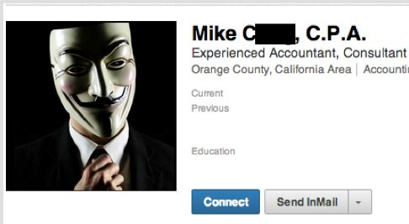
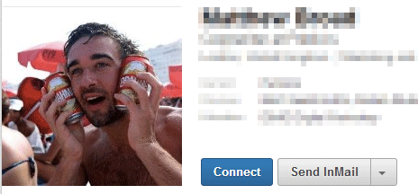
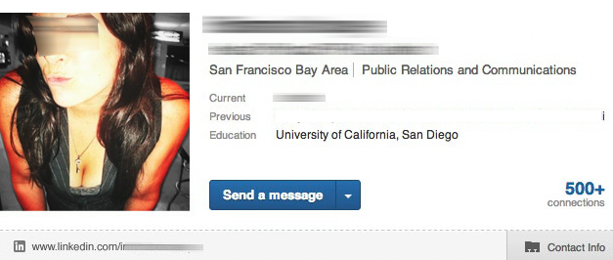
LINKEDIN T TIPS
PROFESSIONAL HEADSHOT
Notes:
Personal Brand: It is important to always keep your audience in mind when using your LinkedIn. The way your profile is set up, the things you post and share are all factors that play a role in the way you will be viewed by your audience.
-Stay up to speed on industry news
Customizing URL: Cut the letters and numbers on the link to make your profile URL a cleaner look.

Slide 23
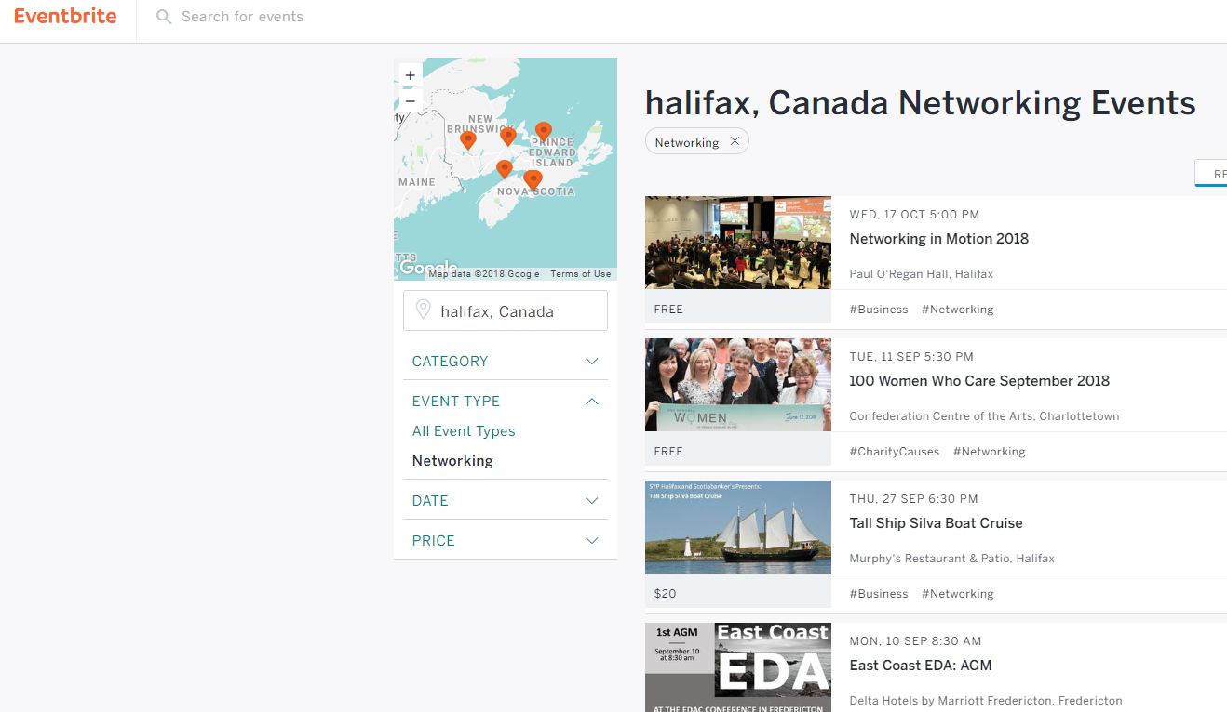
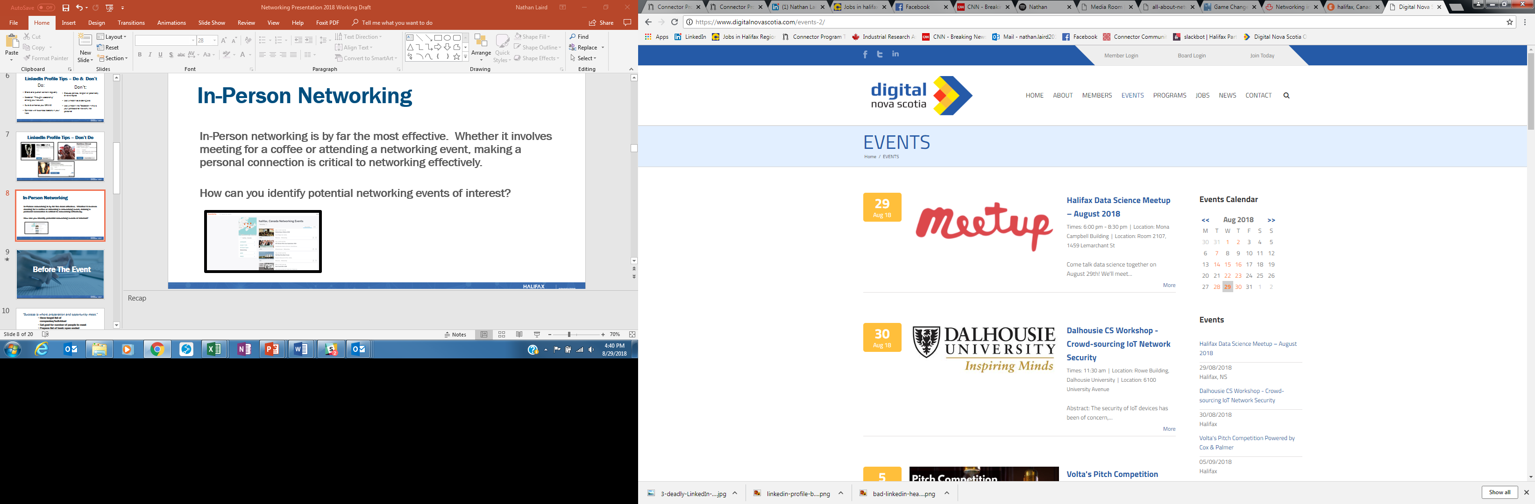
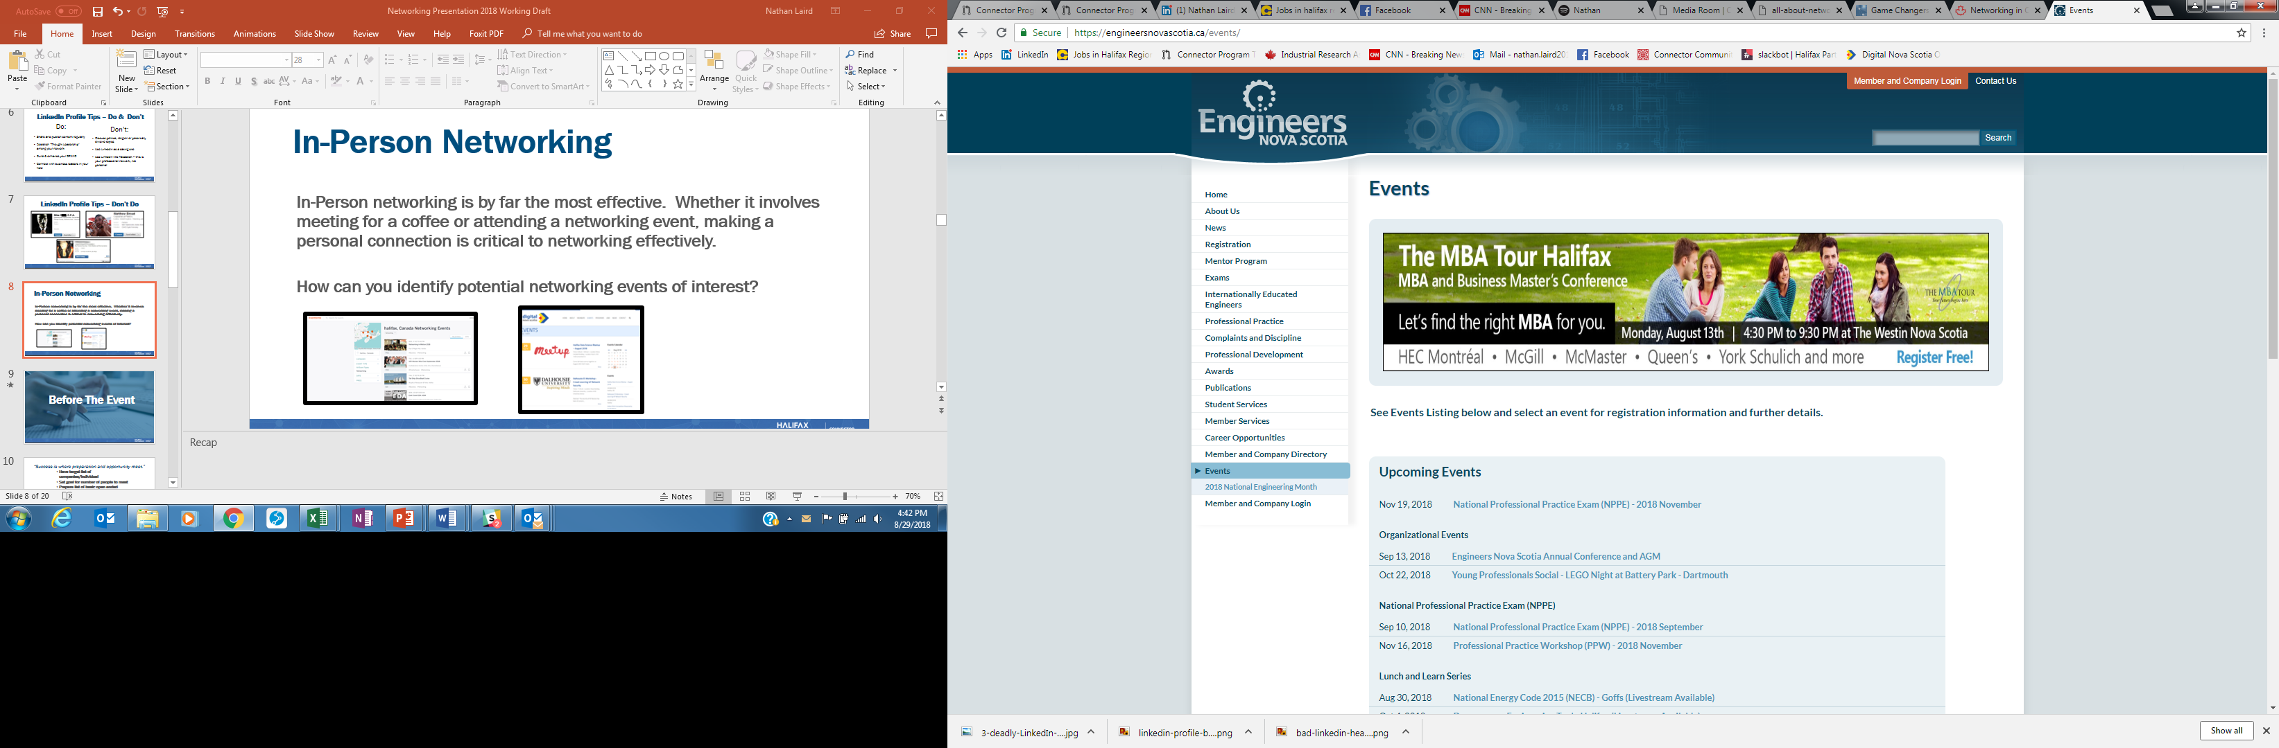
IN-PERSON NETWORKING EVENTS
    In-Person networking is by far the most effective. Whether it involves meeting for a coffee or attending a networking event, making a personal connection is critical to networking effectively.
    How can you identify potential networking events of interest?

Slide 24
IN-PERSON NETWORKING
  Before The Event
Notes:
Discover opportunities
Upcoming short-term projects, volunteer opportunities, conferences, etc.
Tap into the hidden job market
A significant number of jobs are never posted, but rather filled through people leveraging their personal networks
Grow your professional network
Recruiters typically spend about 10 seconds browsing your resume, and having a connection at a given company can help move your resume to the “interview” stack

Slide 25
“Success is where preparation and opportunity meet.”
  Have target list of companies/individual
  Set goal for number of people to meet
  Prepare list of basic open ended questions (include examples)
  Be prepared to speak about your background, understand personal selling points
  Dresscode/First Impression/Branding
  Breath mints
  Business cards easily acceptable
  Psychology of networking events

Slide 26

BUSINESS CASUAL & BUSINESS PROFESSIONAL
Notes:
Personal Brand: It is important to always keep your audience in mind when using your Linkedin. The way your profile is set up, the things you post and share are all factors that play a role in the way you will be viewed by your audience.
Customizing URL: Cut the letters and numbers on the link to make your profile URL a cleaner look.

Slide 27
IN-PERSON NETWORKING
  During The Event
Notes:
Discover opportunities
Upcoming short-term projects, volunteer opportunities, conferences, etc.
Tap into the hidden job market
A significant number of jobs are never posted, but rather filled through people leveraging their personal networks
Grow your professional network
Recruiters typically spend about 10 seconds browsing your resume, and having a connection at a given company can help move your resume to the “interview” stack

Slide 28
HOW DO YOU…
  Approach others?
  Start a conversation?
  Make a genuine connection?
  Swap contacts and exit?
  Remembering names during conversation
  Approach someone having a conversation
  Keep professional…don’t ask for date
Notes:
No interrupting others
Open ended questions:
What kind of projects are you working on right now?
What’s your favorite part of the job?
What do you enjoy doing outside of work?
“be easy to listen” (no complaining, no judging”
the four powerful cornerstones of good conversation spell: honesty (being clear and straight), authenticity (being yourself), integrity (actually doing what you say you will)…You can be honest and authentic by asking genuine questions when a topic comes up that you know nothing about—instead of nodding along
there’s actually a chemical reaction associated with self-disclosure that we find inherently rewarding. For example, instead of talking to someone about how his or her week is going, you can get specific and ask, “What was the highlight of your week?”
Sharing stories creates a connection and stimulates an emotional memories: “Where are you from?” Instead ask: “What are you working on these days?”

Slide 29
TIPS FOR SUCCESSFUL IN-PERSON NETWORKING
Avoid just speaking to friends and colleagues
Avoiding discussing politics and religion
Avoid negativity
Push yourself out of your comfort zone – don’t be intimidated
Don’t be a card spammer or card collector
Maintain eye contact
Ensure a two-way conversation, be genuinely interested
Match handshake
Breath mints
Eating and Drinking at events
Keep one hand free
How long in general to stay with one person

Slide 30
“At the end of the day people won't remember what you said or did, they will remember how you made them feel.” – Maya Angelou
  Keep it positive
  Listen
  Be interested
  No close talking/respect space

Slide 31
IN-PERSON NETWORKING
  After The Event
Notes:
Discover opportunities
Upcoming short-term projects, volunteer opportunities, conferences, etc.
Tap into the hidden job market
A significant number of jobs are never posted, but rather filled through people leveraging their personal networks
Grow your professional network
Recruiters typically spend about 10 seconds browsing your resume, and having a connection at a given company can help move your resume to the “interview” stack

Slide 32

FOLLOW-UP OR FAIL!
  Connect on LinkedIn (NOT Facebook, etc)
  Send an email to follow-up and share contact details.
  Suggest a coffee meeting to have a further discussion
  If you don’t get a response quickly, DO NOT continue to message. Be patient. After about a week, follow up again with a gentle tone.
  Nurture your network, build your brand, and establish “thought leadership” through the material you post/share on LinkedIn.
Do the following within 2-3 days of the event:
Notes:
FOLLOW-UP OR FAIL
Business Cards – Email/LinkedIn 1-3 days after the event. Make notes on the back of the business card. Remind them what you spoke about. If there was a genuine connection you may want to ask to meet for coffee, or you may leave it at “It was great to meet you, I look forward to seeing you at future events”. Perhaps in a few months you want to be connected to that company, and since you already made that initial connection, the doors are open to asking.
NURTURE YOUR NETWORK
How do you stay connected after you added them on LinkedIn, met them for coffee, and thanked them for the advice?
Leverage professional social media sites like LinkedIn and twitter. Engage with your network.

Slide 33
Networking 101
Resume FAQ
PRESENTED BY
Nathan Laird
Presented by:
Nathan Laird, Program Manager, Halifax Connector Program

Slide 34
RESUME REVIEW
Characteristics of a Strong Resume:
  Format – Use a modern template
  Attention to Detail – Proper spelling, grammar and spacing
  Focus on accomplishments
  Skills relevant to the job (customize to the job posting)
  Relevant peripheral skills (i.e. photography, social media, athletics)
  11 or 12 point font (preferably Ariel or Calibri)
  Volunteer experience
  Professional email address
  LinkedIn URL
  White space
Notes:
FOLLOW-UP OR FAIL
Business Cards – Email/LinkedIn 1-3 days after the event. Make notes on the back of the business card. Remind them what you spoke about. If there was a genuine connection you may want to ask to meet for coffee, or you may leave it at “It was great to meet you, I look forward to seeing you at future events”. Perhaps in a few months you want to be connected to that company, and since you already made that initial connection, the doors are open to asking.
NURTURE YOUR NETWORK
How do you stay connected after you added them on LinkedIn, met them for coffee, and thanked them for the advice?
Leverage professional social media sites like LinkedIn and twitter. Engage with your network.

Slide 35
RESUME REVIEW
Characteristics of a Weak Resume:
Errors – grammar & spelling (do you know when to use there, their and they’re?)
Generic skills – listing generic job duties which can be inferred from position title
Listing ridiculous hobbies – i.e. Vodka, Calculations, Netflix n Chill
Using excessive buzzwords – i.e. honest, reliable, trustworthy, hardworking, dedicated, team player
Poor/outdated format
Tiny font size (below 11pt)
No white space
Excessive combining the use of bold, underline and italics
Unprofessional email address (i.e. biggirl2710)
Notes:
FOLLOW-UP OR FAIL
Business Cards – Email/LinkedIn 1-3 days after the event. Make notes on the back of the business card. Remind them what you spoke about. If there was a genuine connection you may want to ask to meet for coffee, or you may leave it at “It was great to meet you, I look forward to seeing you at future events”. Perhaps in a few months you want to be connected to that company, and since you already made that initial connection, the doors are open to asking.
NURTURE YOUR NETWORK
How do you stay connected after you added them on LinkedIn, met them for coffee, and thanked them for the advice?
Leverage professional social media sites like LinkedIn and twitter. Engage with your network.

Slide 36
RESUME REVIEW
Common Mistakes on a Resume:
Photos
Birthdate
Marital Status
Number of Children
Political Affiliation
Religious Affiliation
Notes:
FOLLOW-UP OR FAIL
Business Cards – Email/LinkedIn 1-3 days after the event. Make notes on the back of the business card. Remind them what you spoke about. If there was a genuine connection you may want to ask to meet for coffee, or you may leave it at “It was great to meet you, I look forward to seeing you at future events”. Perhaps in a few months you want to be connected to that company, and since you already made that initial connection, the doors are open to asking.
NURTURE YOUR NETWORK
How do you stay connected after you added them on LinkedIn, met them for coffee, and thanked them for the advice?
Leverage professional social media sites like LinkedIn and twitter. Engage with your network.

Slide 37
RESUME REVIEW
Local Resume Norms:
Length – 2-3 pages depending on experience. Engineers frequently have longer, project-focused resumes
Cover letter is always advised
No need to include References or “References Available Upon Request”
Notes:
FOLLOW-UP OR FAIL
Business Cards – Email/LinkedIn 1-3 days after the event. Make notes on the back of the business card. Remind them what you spoke about. If there was a genuine connection you may want to ask to meet for coffee, or you may leave it at “It was great to meet you, I look forward to seeing you at future events”. Perhaps in a few months you want to be connected to that company, and since you already made that initial connection, the doors are open to asking.
NURTURE YOUR NETWORK
How do you stay connected after you added them on LinkedIn, met them for coffee, and thanked them for the advice?
Leverage professional social media sites like LinkedIn and twitter. Engage with your network.

Slide 38
RESUME REVIEW
Local Resume Resources:
ISANS
Nova Scotia Works
Job Junction
Post-Secondary Career Services Departments
Professional Resume Writers (fee involved)
Notes:
FOLLOW-UP OR FAIL
Business Cards – Email/LinkedIn 1-3 days after the event. Make notes on the back of the business card. Remind them what you spoke about. If there was a genuine connection you may want to ask to meet for coffee, or you may leave it at “It was great to meet you, I look forward to seeing you at future events”. Perhaps in a few months you want to be connected to that company, and since you already made that initial connection, the doors are open to asking.
NURTURE YOUR NETWORK
How do you stay connected after you added them on LinkedIn, met them for coffee, and thanked them for the advice?
Leverage professional social media sites like LinkedIn and twitter. Engage with your network.

Slide 39
Networking 101
Interview FAQ
PRESENTED BY
Nathan Laird
Presented by:
Nathan Laird, Program Manager, Halifax Connector Program

Slide 40

INTERVIEW FAQ
By The Numbers…
On average, each corporate job posting attracts 250 resumes. Of those candidates, 4 to 6 will get called for an interview, and only one will get the job.
(Glassdoor)
87% of recruiters use LinkedIn to check candidates.
(Jobvite Recruiter Nation Report 2016)
Average time-to-hire a new employee was 39 days in 2016, down from 43 days in 2015.
(Jobvite 2017 Recruiting Funnel Benchmark Report)
Average cost per hire for companies is $4,129.
(SHRM Human Capital Benchmarking Report 2016)
Notes:
FOLLOW-UP OR FAIL
Business Cards – Email/LinkedIn 1-3 days after the event. Make notes on the back of the business card. Remind them what you spoke about. If there was a genuine connection you may want to ask to meet for coffee, or you may leave it at “It was great to meet you, I look forward to seeing you at future events”. Perhaps in a few months you want to be connected to that company, and since you already made that initial connection, the doors are open to asking.
NURTURE YOUR NETWORK
How do you stay connected after you added them on LinkedIn, met them for coffee, and thanked them for the advice?
Leverage professional social media sites like LinkedIn and twitter. Engage with your network.

Slide 41

INTERVIEW FAQ
Keys to a Successful Interview:
PREPARATION & RESEARCH
Arrival/Waiting Area
“The Walk”/Introductions
The Interview
Questions
Next Steps
Salary Discussion
Notes:
FOLLOW-UP OR FAIL
Business Cards – Email/LinkedIn 1-3 days after the event. Make notes on the back of the business card. Remind them what you spoke about. If there was a genuine connection you may want to ask to meet for coffee, or you may leave it at “It was great to meet you, I look forward to seeing you at future events”. Perhaps in a few months you want to be connected to that company, and since you already made that initial connection, the doors are open to asking.
NURTURE YOUR NETWORK
How do you stay connected after you added them on LinkedIn, met them for coffee, and thanked them for the advice?
Leverage professional social media sites like LinkedIn and twitter. Engage with your network.

Slide 42
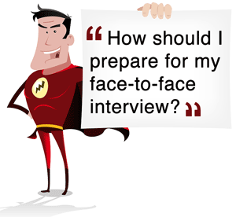
INTERVIEW FAQ
Preparation & Research:
Company Research – review & makes notes on company website, annual reports, social media feeds, press releases, etc. Understand their business and what value you can offer.
Interviewer Research – checked LinkedIn pages of interviewers. Understand their background and look for overlap
Interview Research – review the job description and create talking points about yourself that relate to the job. Anticipate potential questions and formulate talking points for each.
Research directions to interview location in advance…never ask a potential employer for directions or transit routes
Choose wardrobe in advance, ensure clothes are pressed and shoes shined.
Notes:
FOLLOW-UP OR FAIL
Business Cards – Email/LinkedIn 1-3 days after the event. Make notes on the back of the business card. Remind them what you spoke about. If there was a genuine connection you may want to ask to meet for coffee, or you may leave it at “It was great to meet you, I look forward to seeing you at future events”. Perhaps in a few months you want to be connected to that company, and since you already made that initial connection, the doors are open to asking.
NURTURE YOUR NETWORK
How do you stay connected after you added them on LinkedIn, met them for coffee, and thanked them for the advice?
Leverage professional social media sites like LinkedIn and twitter. Engage with your network.

Slide 43

INTERVIEW FAQ
The Arrival/Waiting Area:
Plan to leave early enough to arrive in the interview area 30-40 minutes early. Leave a buffer for traffic. DO NOT go to the interview location more than 5-10 minutes beforehand. Find a coffee shop to wait in and mentally prepare
Visit the bathroom prior to going to interview
Be sure to bring a notebook and pen for notes
TURN YOUR PHONE OFF…not vibrate, totally silent. Don’t be on your phone in the waiting area
DO NOT wear perfume or cologne
Be very nice to the receptionist, they are often asked how candidates behave
Accept a glass of water, you’re about to be talking a lot
Notes:
FOLLOW-UP OR FAIL
Business Cards – Email/LinkedIn 1-3 days after the event. Make notes on the back of the business card. Remind them what you spoke about. If there was a genuine connection you may want to ask to meet for coffee, or you may leave it at “It was great to meet you, I look forward to seeing you at future events”. Perhaps in a few months you want to be connected to that company, and since you already made that initial connection, the doors are open to asking.
NURTURE YOUR NETWORK
How do you stay connected after you added them on LinkedIn, met them for coffee, and thanked them for the advice?
Leverage professional social media sites like LinkedIn and twitter. Engage with your network.

Slide 44

INTERVIEW FAQ
The Interview:
Be sure to make eye contact with each person (if it’s a panel interview) as you’re answering questions
Give concise, detailed answers about your skills and ACCOMPLISHMENTS. Don’t ramble.
If you’re asked a question that you don’t immediately know an answer for, ask if you can have a moment to think about it
Frame your answers in a way that shows the value you can bring to the organization.
Pay attention to posture and tone of voice…appear confident
Notes:
FOLLOW-UP OR FAIL
Business Cards – Email/LinkedIn 1-3 days after the event. Make notes on the back of the business card. Remind them what you spoke about. If there was a genuine connection you may want to ask to meet for coffee, or you may leave it at “It was great to meet you, I look forward to seeing you at future events”. Perhaps in a few months you want to be connected to that company, and since you already made that initial connection, the doors are open to asking.
NURTURE YOUR NETWORK
How do you stay connected after you added them on LinkedIn, met them for coffee, and thanked them for the advice?
Leverage professional social media sites like LinkedIn and twitter. Engage with your network.

Slide 45

INTERVIEW FAQ
Ask Questions:
At the end of an interview, you have 2-3 intelligent questions to ask. Have these prepared in advance.
Sample questions could include:
  Ask what success looks like in the role
  Ask what are the key traits/skills that will enable someone to be successful
  Ask a question about the company’s direction, or new products being launched
  Ask about the company culture
At this point, avoid asking salary-related questions
Notes:
FOLLOW-UP OR FAIL
Business Cards – Email/LinkedIn 1-3 days after the event. Make notes on the back of the business card. Remind them what you spoke about. If there was a genuine connection you may want to ask to meet for coffee, or you may leave it at “It was great to meet you, I look forward to seeing you at future events”. Perhaps in a few months you want to be connected to that company, and since you already made that initial connection, the doors are open to asking.
NURTURE YOUR NETWORK
How do you stay connected after you added them on LinkedIn, met them for coffee, and thanked them for the advice?
Leverage professional social media sites like LinkedIn and twitter. Engage with your network.

Slide 46

INTERVIEW FAQ
Next Steps:
Prior to leaving an interview, verify what the next steps are. This will give you an idea of what to expect moving forward.
After the interview, send a thank you note to all those involved
DO NOT overwhelm the recruiter by reaching out too soon for updates. If the timeline they provided for next steps has passed, then it is acceptable to follow up.
When the interview ends, thank everyone for their time and the opportunity, and shake everyone’s hand (if possible)
Notes:
FOLLOW-UP OR FAIL
Business Cards – Email/LinkedIn 1-3 days after the event. Make notes on the back of the business card. Remind them what you spoke about. If there was a genuine connection you may want to ask to meet for coffee, or you may leave it at “It was great to meet you, I look forward to seeing you at future events”. Perhaps in a few months you want to be connected to that company, and since you already made that initial connection, the doors are open to asking.
NURTURE YOUR NETWORK
How do you stay connected after you added them on LinkedIn, met them for coffee, and thanked them for the advice?
Leverage professional social media sites like LinkedIn and twitter. Engage with your network.

Slide 47
INTERVIEW FAQ
Salary Discussion:
Avoid discussing salary too early on in an interview process. If companies sense a candidate’s primary motivator is financial, many will pass as they fear the candidate would leave for slightly better compensation.
Review sites like the Government of Canada Job Bank or Glassdoor to get an idea of what the salary range for a given position may be. This will provide an idea on the range if a potential employer insists on being given a salary range
It is best, when possible, to leave salary discussions to the end of an interview cycle to allow the candidate to build value in their skills and background. Build value in what you offer and the salary discussion will be much easier.
Remember the line “If I’m fortunate enough to be offered the position, I’ll strongly consider your best offer.”
Notes:
FOLLOW-UP OR FAIL
Business Cards – Email/LinkedIn 1-3 days after the event. Make notes on the back of the business card. Remind them what you spoke about. If there was a genuine connection you may want to ask to meet for coffee, or you may leave it at “It was great to meet you, I look forward to seeing you at future events”. Perhaps in a few months you want to be connected to that company, and since you already made that initial connection, the doors are open to asking.
NURTURE YOUR NETWORK
How do you stay connected after you added them on LinkedIn, met them for coffee, and thanked them for the advice?
Leverage professional social media sites like LinkedIn and twitter. Engage with your network.

Slide 48


