Slide 1
We ALL are Connectors

Slide 2
“Connects community and business people (Connectors) with employment-ready immigrant professionals (Connectees) in the same Industry”
Connectee’s Selection Criteria:
Permanent Resident of Canada
Hold a professional qualification, skilled trade certificate, undergraduate or graduate degree from outside of Canada.
Obtain language level is at a CLB 6 or higher.
Referred by an employment counsellor. (Please see Referral Service Providers)

Slide 3
Connectee
Program
Co-ordinator
Connector

Slide 4
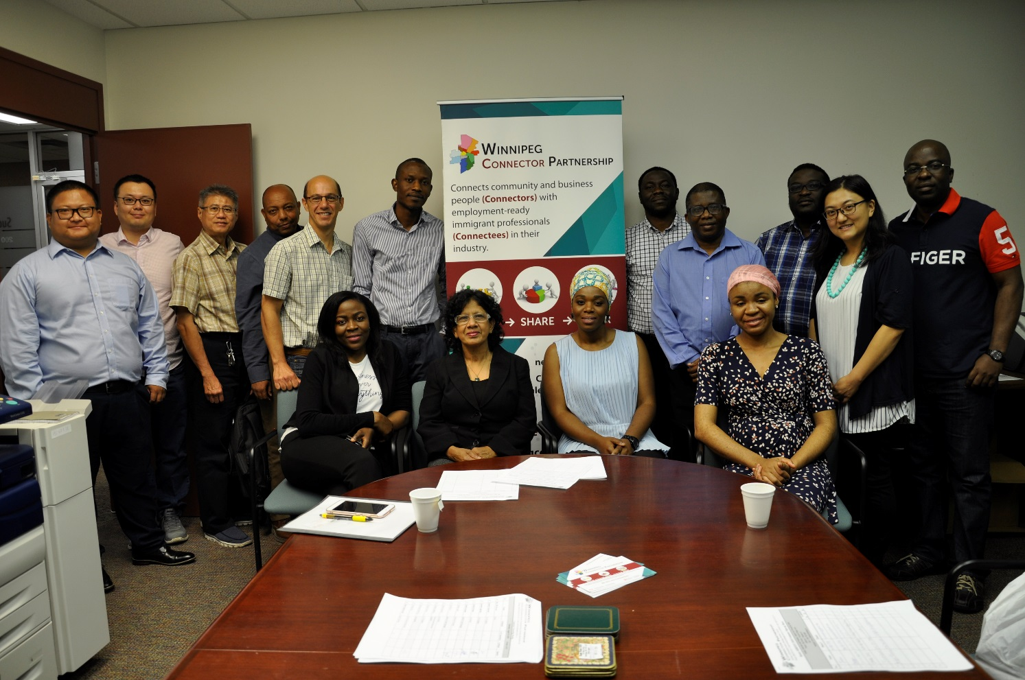
BEST PRACTICE
Orientation of connectors and connectees separately

Slide 5
All group meetings include breaks and refreshments to allow for informal conversations among connectors and connectee peers.

Slide 6
BEST PRACTICE
Group meetings must identify sequenced progression of topics being covered or practised.

Slide 7
Mindful Networking

Slide 8
Best Practice
Meetings and agendas are published on the common communication website to reduce emailing.
www.wpgconnector.ca

Slide 9
10, 30, 60 Pitch

Slide 10
BEST PRACTICE
To ensure that connectors can disconnect from their one-on-one communications in the time frames to which they have committed themselves, connectees are briefed when they join the program and the importance of respecting the 30-minute connector commitment to the program. Choice of extending the time or number of meetings is made clear to be the connector’s decision.

Slide 12
BEST PRACTICE
Use of visuals, practical hands on exercises, occupation-specific or sector-specific groupings with related guest speakers help make the follow-up connecter-connecter one-on-one more focussed.

Slide 13
Civil/Project Management Meeting

Slide 14
IT/Project Management Speed Interview

Slide 15
Networking Presentation/Why Networking Important?

Slide 16
BEST PRACTICE
Unique situations demand unique approaches. We use an office for some connecters to meet connectees who have some challenges which require some specialized approaches and attention.

Slide 17
Engineering Networking Meeting

Slide 18
Rotary Club Of Winnipeg Peace Days Event

Slide 19
Staff Police Experience

Slide 20
Be the Change (second year)

Slide 21
Multicultural event

Slide 22
Connectee Surveys
Did you find this meeting helpful toward your job search?
Was this connection relevant to your field of study and professional Interests?
Would you consider meeting with another Connector?
Would you recommend this connector to another participant in the program?
Was the Connector able to provide you with additional contacts?

Slide 23
BEST PRACTICE
The Rotary Club of Winnipeg, Toastmasters International, and Winnipeg Connector Partnership collaborated and Charter a new Toastmasters club for Connectors and Connectees.
The Winnipeg Peace Builders Toastmasters Club.

Slide 24
Thank You! Questions?????
…“Sprinkled among every walk of life …are a handful of people with a truly extraordinary knack of making friends and acquaintances. They are Connectors.” Malcolm Gladwell’s from the Tipping Point.
connector@wpgconnector.ca
www.wpgconnector.ca

